Slide 1






Poetic Vocabulary

Slide 2
Match the words with their definitions
a young man who is a lover or suitor.
b. a state of extreme happiness or joy.
c. blood that has come out of a wound.
d. a kingdom or domain where someone has control or influence.
e. a person who is under the control or domination of another.
f. one's range of knowledge or understanding.
g. intense anger or wrath.
h. a horse, especially a riding horse.
i. a large group or collection of things, people, or ideas that are arranged in an organized way.
j. a long search or pursuit for something.
k. a drinking glass with a stem and a base, often used for wine.
l. to swell out and become larger, like a cloud or sail filled with wind.
m. great sorrow or distress.
n. great strength or power.
o. a state of well-being or prosperity.
p. a wedding ceremony or marriage.
q. a solemn pledge or promise, especially in relation to marriage.
r. an enemy or opponent.
s. the use of clever but dishonest behavior to deceive someone.
1. ken
2. guile
3. steed
4. woe
5. might
6. quest
7. ire
8. billow
9. troth
10. gore
11. realm
12. weal
13. nuptials
14. foe
15. goblet
16. swain
17. bliss
18. thrall
19. array

Slide 3
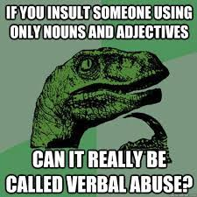
https://wordwall.net/play/62998/376/906
Poetic Adjectives

Slide 4

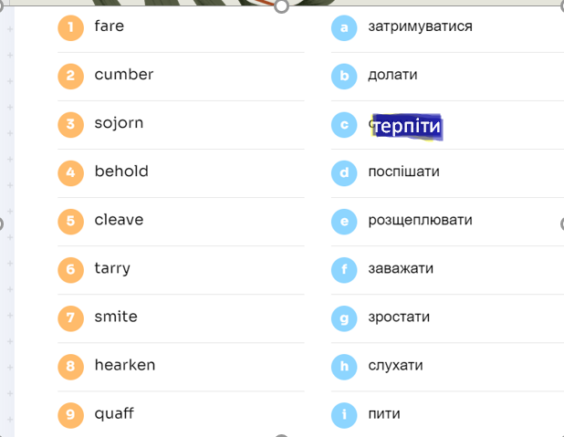
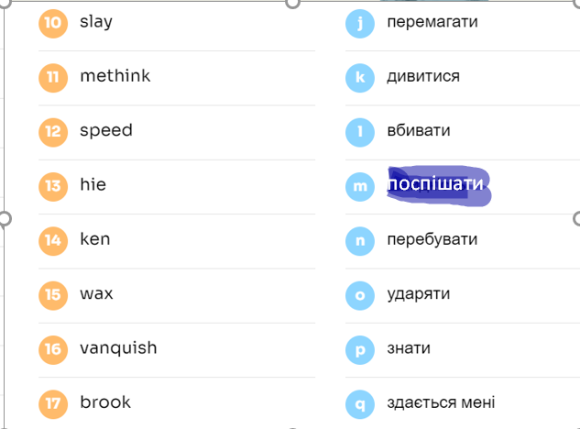

Slide 5

Group Tasks
Vocabulary story
Word Association
Take each word and brainstorm related words or concepts
Dialogue
Use as many words as you can in your dialogues
Use as many words as you can

Slide 6
Modern Examples

Slide 7
Thanks!

