Slide 1

КРЕОЛІЗОВAНА ПОЕЗІЯ CREOLISED POETRY
.
Tetyana Kozlova
Zaporizhzhia National University, Ukraine

Slide 2
Поняття мультимодального vs креолізованого тексту
If the Earth were … by J. Miller
Різні прочитання – різні візуалізації
https://www.youtube.com/watch?v=f8Df4udgLxs
David Bayliss, from a freely distributable domain resource of TS Production LLC
https://www.youtube.com/watch?v=F-B0mq25Czc
Read aloud: If the Earth were a Few Feet in diameter. Eco chick.

Slide 3
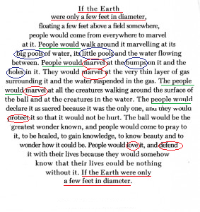
ПРИКЛАД КРЕОЛІЗОВАНОГО / МУЛЬТИМОДАЛЬНОГО ТЕКСТУ
Joe Miller. If the Earth were … [MEWFFD 1998]
Еквівалентність між позначувальним та позначуваним суміщає геометричну
візуалізацію концепту ВСЕСВІТ = СФЕРА

Slide 4
Ut Pictura Poesis: The Verbal-Visual Synthesis in William Blake’s Poetic Worldview
.
Ut Pictura Poesis: Вербально-візуальний синтез в авторській поетичній картині світу В. Блейка

Slide 5
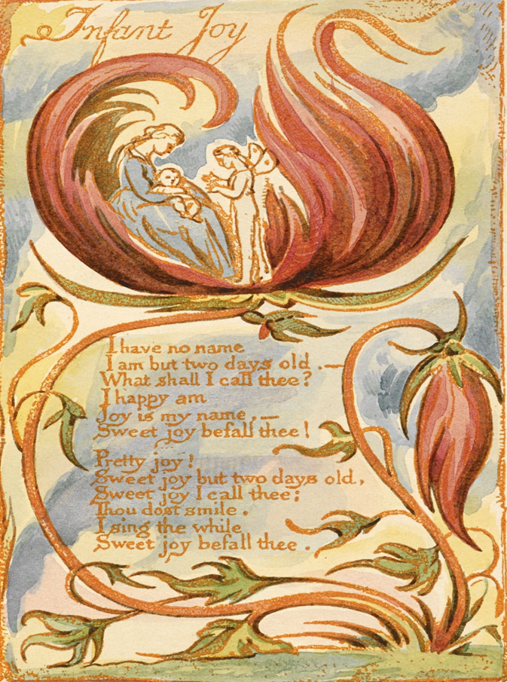
WHY STUDY A MULTIMODAL FORMAT IN POETRY ?
integrated view of human creativity
focus on individual motivation
bridging the gap between mind and world
application of new methods to research polycoding means of concept representation by an individual

Slide 6
W. BLAKE’S POETIC AND ARTISTIC WORKS FROM VARIOUS PERSPECTIVES https://www.youtube.com/shorts/Cl7YggyUDak
ASPECTS ALREADY STUDIED BY OTHER RESEARCHERS
literary studies (Adams 2014; Roberts 2007; Rudd 2016 )
semiotics (Damon 2013)
translation studies 20 (Haddad 2020; Stewart 2020)
cognitive poetics (Adams 1993, 2014; Murray 2020; Petrovic 2015 )
THE NEED FOR MORE INVESTIGATION
inextricable intertwine between the poetry and imprints in Blake’s book productions
NEW APPROACH
William Blake as an artistic poet synthesizing poetic and artistic methods in creating picturesque poetic texts
https://www.youtube.com/watch?v=U4vAeVW7iOA

Slide 7
IN THIS STUDY
The purpose was to examine the multimodal space of William Blake’s poetic worldview.
It is argued that Blake’s self-illustrated poetry collections employed verbal and visual means to elaborate his individual worldview. Created separately but used together, they reflected unified embodied conceptualizations.

Slide 8
METHODS AND MATERIALS
SOURCES William Blake’s illustrated books
DATA 130 lyrical and prophetic poems, 200 imprints and drawings
INTERDISCIPLINARY METHODS
contextual, componential, and conceptual analysis used in linguistics
basic principles of the description of works of fine arts
THEORETICAL BASIS FOR THE RESEARCH
the theory of aesthetic experience and creativity in arts and literature (Horace; Deming 2018)
the theory of semiotic constructs consisting of several codes and cooperating in the production of meaning (Zhang & Feng 2000)
the theory of language worldview (Weisgerber; Humboldt; Naugle 2002; Głaz 2022)
the theory of iconicity (Kozlova 2015)
the theory of cognitive metaphor (Snævarr 2010)

Slide 9
VERBAL-VISUAL INTEGRITY OF W. BLAKE’S POETIC SPACE
artistic interpretation of the world based on the rules of beauty
extended and varied dimensions of the worldview
visual enrichment of the stories, not duplication
unique multimodal conception of the Universe

Slide 10
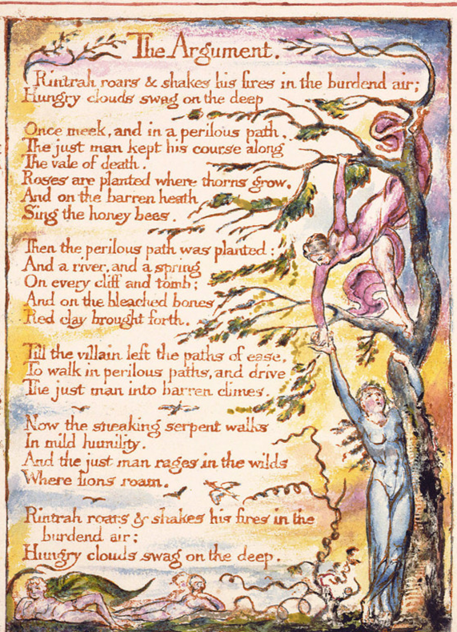
BLAKE’S VERBAL-VISUAL SYNTHESIS: SALIENCE ON THE VERTICAL
THE WORLD IS REVEALED VERTICALLY THROUGH LEXICAL ELABORATION
“Thro’ the Heaven and Earth and Hell…”
MOST FREQUENT VERBALIZATIONS (43.5%)
up, high, heaven, cloud, sky, hill, mountain, rock,
sun, moon
PREVAILING DESIGNATIONS (56.5% )
bottom (down, under, hole, grave ),
the middle layer (earth, ground, land),
water space (stream, river, sea)
the upper part (verbs of vertical movement)
“I see thy dark clouds ascend”
“Rush’d down like floods from his mountains”
“Over the doors … and over the chimneys…”

Slide 11
BLAKE’S VERBAL-VISUAL SYNTHESIS: SALIENCE ON THE VERTICAL
MANIPULATING THE VIEWER’S POSITION
DRAWING FROM BELOW
VIOLATING THE PRINCIPLE OF ORDERING AND PERSPECTIVE

Slide 12
BLAKE’S VERBAL-VISUAL SYNTHESIS: THE FIGURE / GROUND
ALIGNMENT
visual means
vertical format
equal share of space between the text and the pictures
framed poem – unity between the nature and people
verbal means
the image of beaming nature
“…the green woods laugh …the dimpling stream runs laughing… the air does laugh …the green hill laughs … the meadows laugh … the grasshopper laughs …the painted birds laugh”

Slide 13
BLAKE’S VERBAL-VISUAL SYNTHESIS:
COMPLEMENTARY REPRESENTATION OF SCENES
falling asleep as a transition from wakefulness to sleepiness
visual means
gradual change of colours
(transparent yellow > dark blue > opaque dark blue )
verbal means
verbs denoting creation
(‘begin to exist’ as in form a shade,
‘make a path by moving quickly,
or twisting’ as in weave the brows)

Slide 14
BLAKE’S VERBAL-VISUAL SYNTHESIS:
IMAGIC AND DIAGRAMMATICAL ICONICITY
Mimicking STILLNESS and SAMENESS
the most of the vertical imprint space
broad tonal range of the same colour
alliteration
…silent delight,
Sits and smiles…
anaphoric repetition and polysyndeton
And keep them …
And pitying the tender …
And walking round…
And now beside thee …

Slide 15
CONCLUSION
the hybrid representation of Blake’s poetic worldview resulted in:
the multimodal manifestation of the centerpiece and less-central concepts;
the complementarity of verbal and visual dimensions in multimodal complexes ;
the manifestation of the order of the universe as imagined and considered fair by the poet;
the increased salience of relevant information, more varied imagery and its elaborate encoding;
the shift of the onus for communicating ideas from the poet onto the painter and vice versa;
the findings support the hypothesis that created separately but used together, verbal and visual representations made a demand for each other as they reflected unified embodied conceptualizations of the author

Slide 16
Яскравим прикладом еквівалентності між позначувальним та позначуваним є креолізований текст (Рисунок 1.6), який суміщає геометричну візуалізацію концепту ВСЕСВІТ = СФЕРА та різні вербальні засоби його діаграматизації:
Joe Miller. If the Earth were …
[MEWFFD 1998]

Slide 17
Креолізований текст і комбінована діаграматизація концепту
ВСЕСВІТ = СФЕРА
фреймінг – If the earth were only a few feet in diameter <…> If the earth were only a few feet in diameter;
анафора – (The) people would…;
паралельні конструкції – people would come…, people would walk…; people would marvel…, people would love…;
антонімічна конденсація – big pools and little pools, bumps and holes, be hurt – be healed, somewhere – everywhere .
синонімічна конденсація – love – marvel, protect – defend.
Різними вербальними засобами (синтаксичний паралелізм, лексичний повтор, антитеза) прозоро актуалізовано такі концептуальні ознаки
– ‘замкнута поверхня, яка не має ані початку, ані кінця’ (СФЕРА = ЗЕМНА КУЛЯ), ‘точки, рівновіддалені від центру’ (СФЕРА) = ‘сукупність усіх (різних і подібних) форм матерії як єдине ціле’ (ЗЕМНА КУЛЯ)’ тощо.
Іконічність різнорівневих одиниць полегшує декодування інформації реципієнтом у процесі комунікативного акту та сприяє економії зусиль мовців при виборі найефективнішого засобу передачі інформації.

