Slide 1

What is rhetoric?

Slide 2
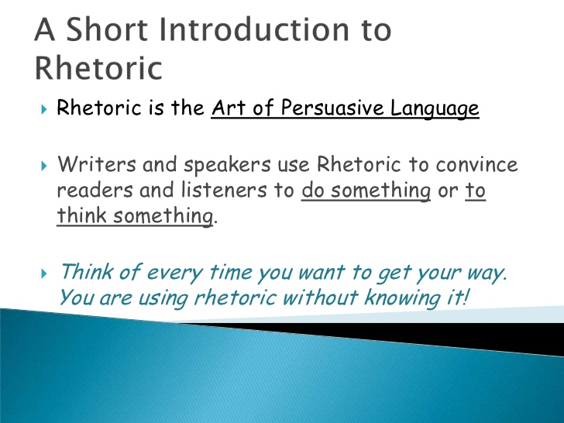

Slide 3
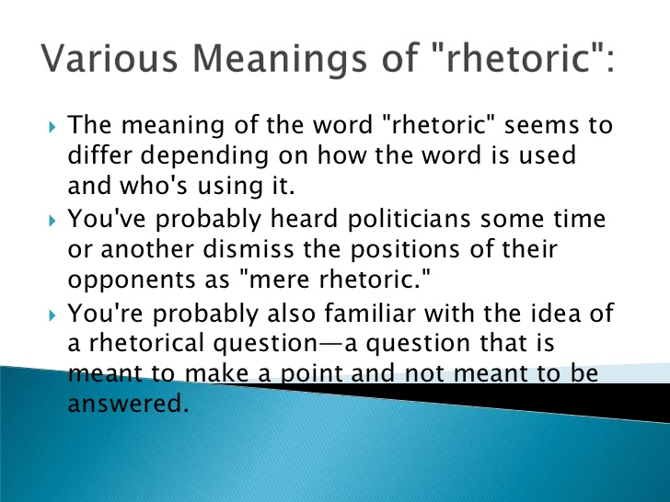

Slide 4
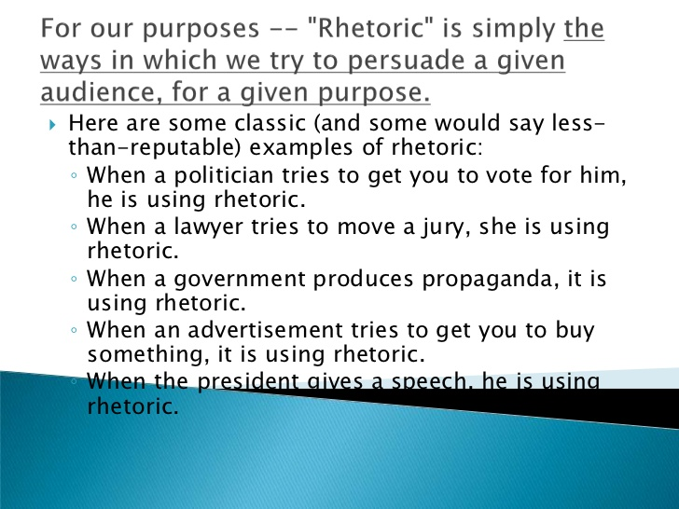

Slide 5
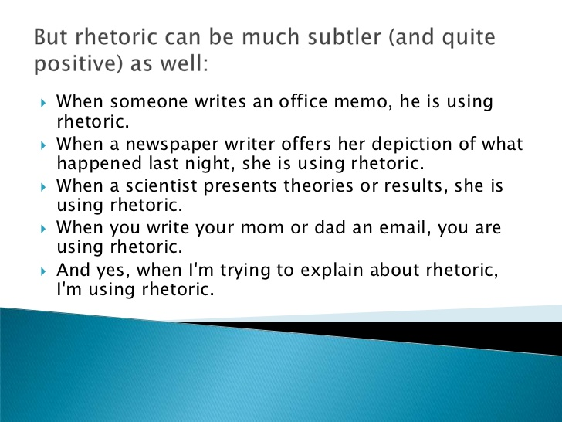

Slide 6
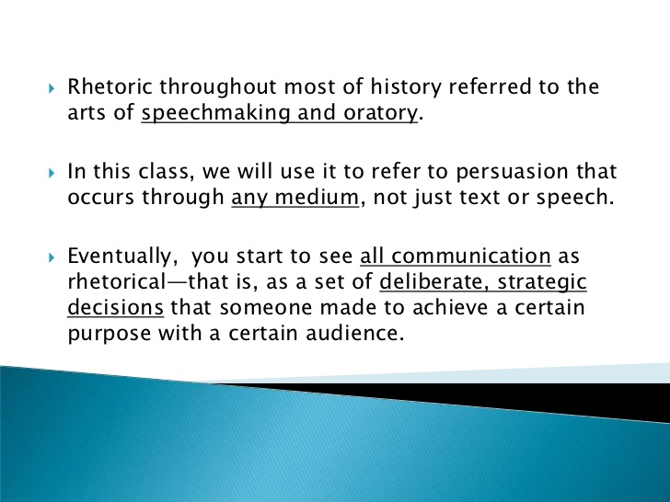

Slide 7
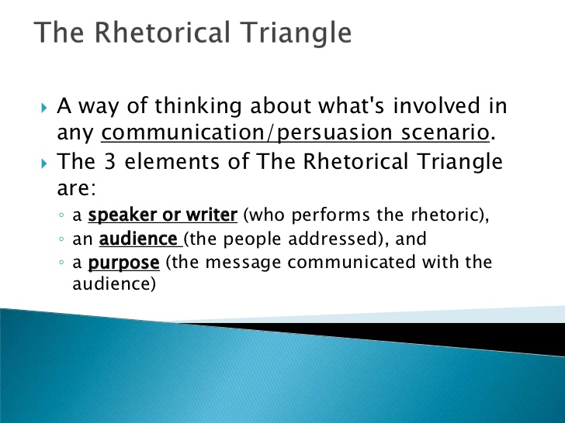

Slide 8
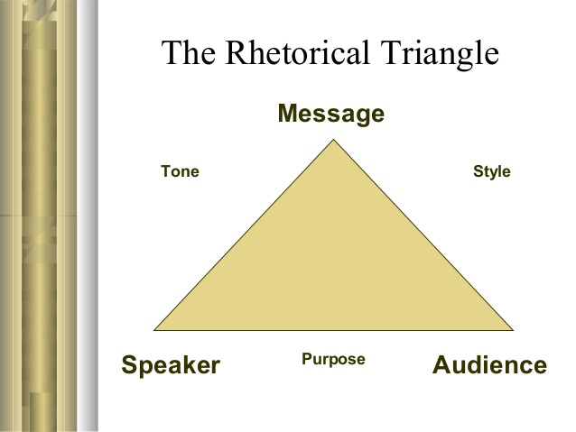

Slide 9
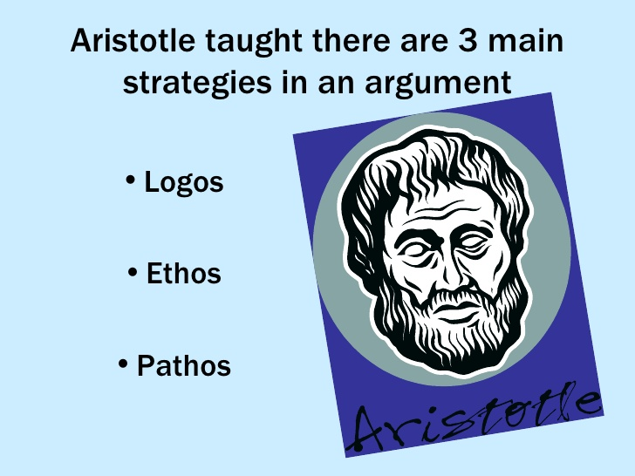

Slide 10
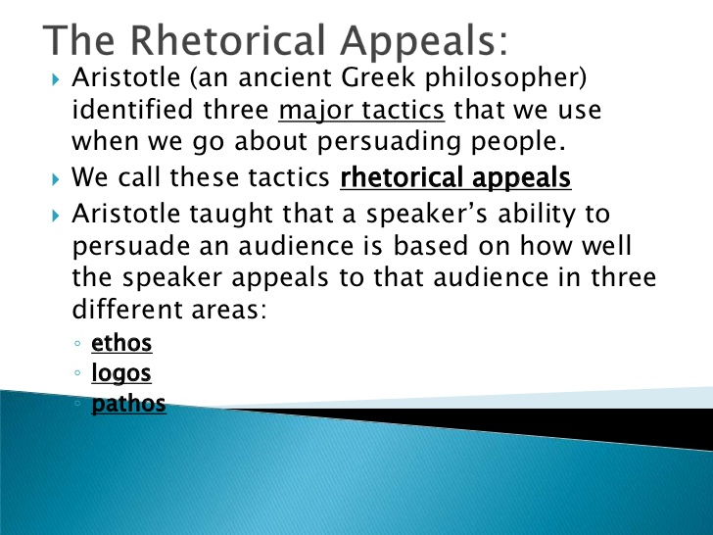

Slide 11
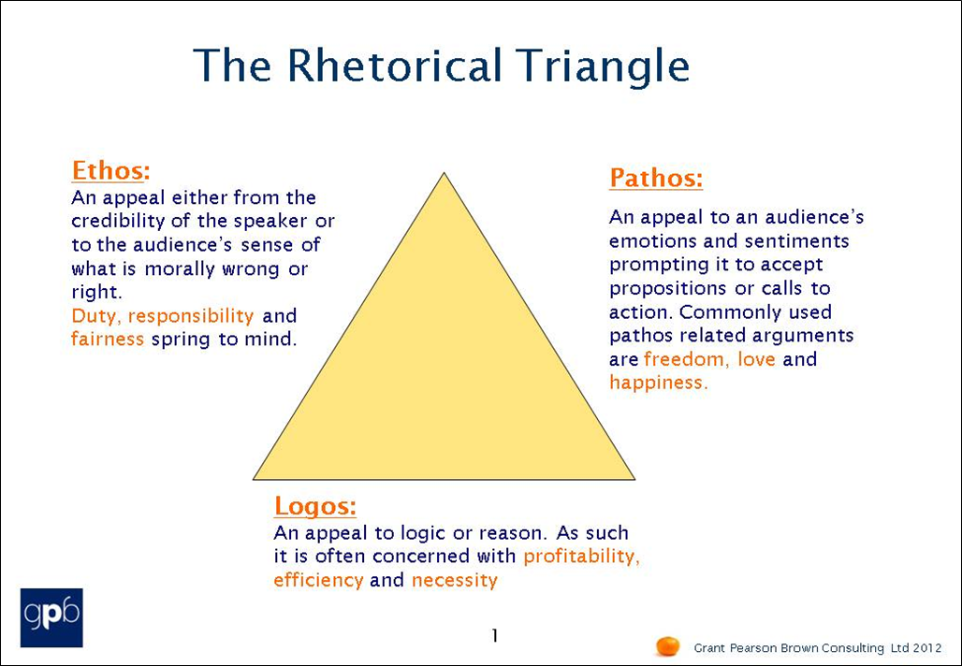

Slide 12
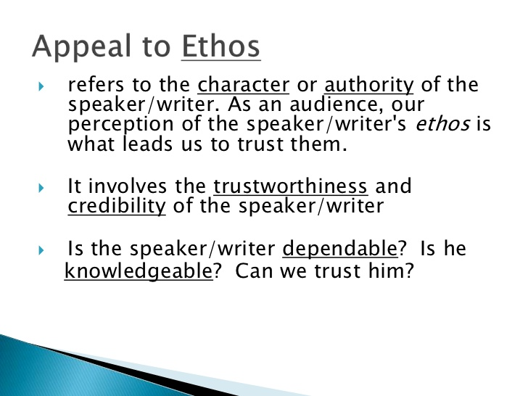

Slide 13
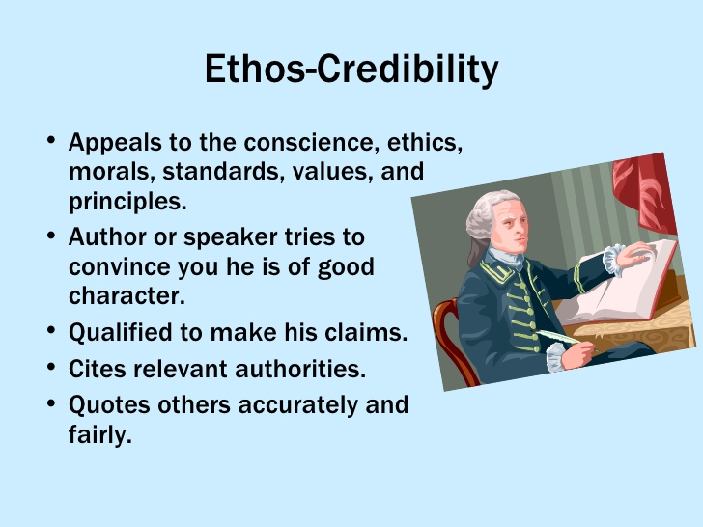

Slide 14
Ethos Example
In the following example, note how Nancy Mairs establishes her credibility and trustworthiness and authority to write about this subject by being honest. Mairs admits she is uncertain about her own motives and shows she understands the discomfort others’ have with this subject.

Slide 15
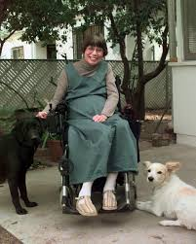
People—crippled or not—wince at the word “cripple,” as they do not at “handicapped” or “disabled.” Perhaps I want them to wince. I want them to see me as a tough customer, one to whom the fates/gods/viruses have not been kind, but who can face the brutal truth of her existence squarely. As a cripple, I swagger.
—Nancy Mairs, “On Being a Cripple”

Slide 16
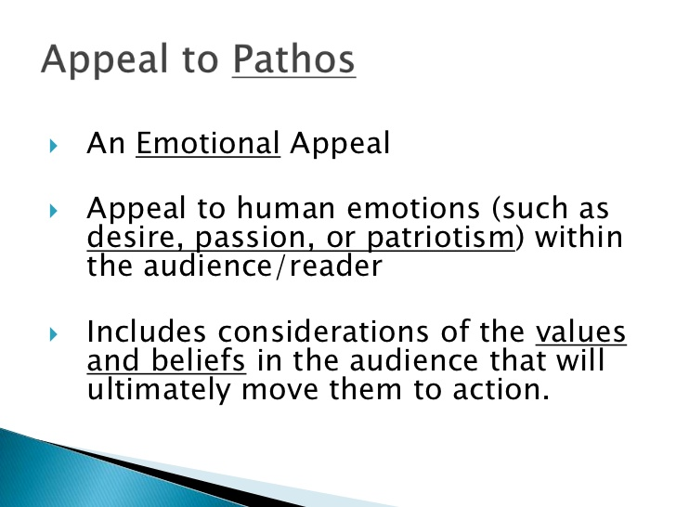

Slide 17
In the following example from a speech by Winston Churchill, note the use of anaphora (repetition of a word or group of words at the beginning of items in a series).
This repetition emphasizes the point and expresses passion and emotion. Moreover, the repetition affects the audience emotionally.

Slide 18
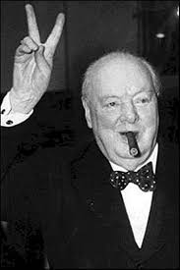
We shall not flag or fail. We shall go on to the end. We shall fight in France, we shall fight on the seas and oceans, we shall fight with growing confidence and growing strength in the air, we shall defend our island, whatever the cost may be, we shall fight on the beaches, we shall fight on the landing grounds, we shall fight in the fields and in the streets, we shall fight in the hills. We shall never surrender.
Winston Churchill, speech to the House of Commons, June 4, 1940

Slide 19
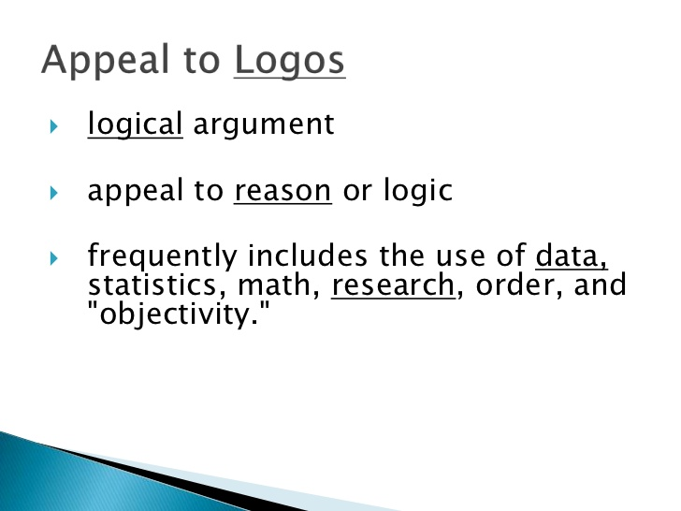

Slide 20
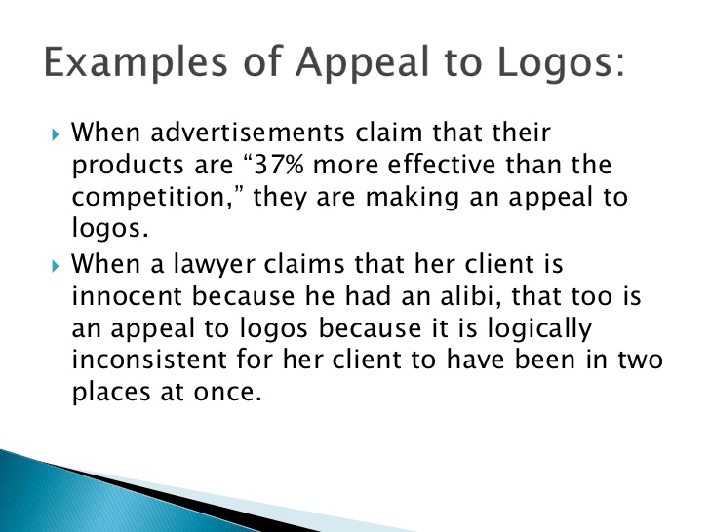

Slide 21
In the following example, note how Ian Ayres uses evidence from experience (her work environment, Delta Airlines, the University of Chicago). This evidence establishes the precedent that Ayres uses to compare to the current situation that she argues should be changed.

Slide 22
We don’t have single-sex toilets at home, and we don’t need them at the office. Then there’s also the small question of efficiency. I see my male colleagues waiting in line to use the men’s room, when the women’s toilet is unoccupied. Which is precisely why Delta Airlines doesn’t label those two bathrooms at the back of the plane as being solely for men and women. It just wouldn’t fly.

Slide 23
