Slide 1
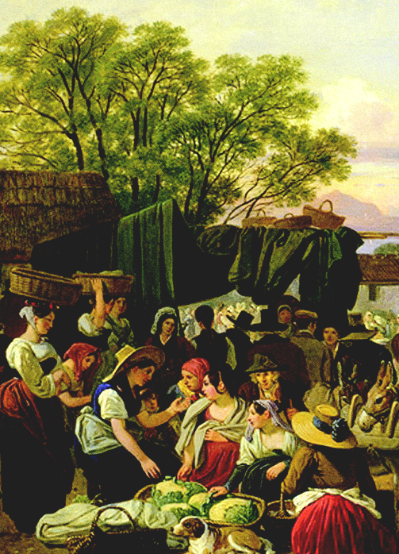
N. Gregory Mankiw
Principles of
Macroeconomics
Sixth Edition
19
Notes:
<номер>

Slide 2
2. In this topic,
look for the answers to these questions:
In an open economy, what determines the real interest rate? The real exchange rate?
How are the markets for loanable funds and foreign-currency exchange connected?
How do government budget deficits affect the exchange rate and trade balance?
How do other policies or events affect the
interest rate, exchange rate, and trade balance?
Notes:
<номер>

Slide 3
3. The Market for Loanable Funds
An identity from the preceding chapter:
S = I + NCO
Saving
Net capital outflow
Domestic investment
Supply of loanable funds = saving.
A dollar of saving can be used to finance
  the purchase of domestic capital
  the purchase of a foreign asset
So, demand for loanable funds = I + NCO
Notes:
<номер>
<номер>

Slide 4
4.The Market for Loanable Funds
Recall:
  S depends positively on the real interest rate, r.
  I depends negatively on r.
What about NCO?
Notes:
<номер>
<номер>

Slide 5
5. How NCO Depends on the Real Interest Rate
The real interest rate, r,
is the real return on
domestic assets.
A fall in r makes domestic assets less attractive
relative to foreign assets.
  People in the U.S. purchase more foreign assets.
  People abroad purchase fewer U.S. assets.
  NCO rises.
Net capital outflow
r
r₁
r₂
NCO
NCO
NCO₁
NCO₂
Notes:
<номер>
<номер>

Slide 6
6. Equilibrium
The interest rate adjusts to equate supply and demand.
Interest
Rate
Supply
The eq’m quantity of L.F. equals eq’m investment and eq’m saving.
5%
Demand
60
Loanable Funds ($billions)
Notes:
<номер>
<номер>

Slide 7
7. The Loanable Funds Market Diagram
r adjusts to balance supply and demand in the LF market.
Loanable funds
r
S = saving
Both I and NCO
depend negatively on r,
so the D curve is downward-sloping.
r₁
D = I + NCO
LF
Notes:
<номер>
<номер>

Slide 8
8. The Market for Foreign-Currency Exchange
Another identity from the preceding chapter:
NCO = NX
Net capital outflow
Net exports
In the market for foreign-currency exchange,
  NX is the demand for dollars:
  Foreigners need dollars to buy U.S. net exports.
  NCO is the supply of dollars:
  U.S. residents sell dollars to obtain the foreign currency they need to buy foreign assets.
Notes:
<номер>
<номер>

Slide 9
9.The Market for Foreign-Currency Exchange
NX is positive
  We send more goods abroad than we import.
  Therefore, foreigners buy this excess with our money.
  They get our money by selling us some of theirs.
  We now have claims on foreign assets, so NCO is also positive.
Notes:
<номер>
<номер>

Slide 10
10. The Market for Foreign-Currency Exchange
When NX is negative
  We import more goods abroad than we send abroad.
  Therefore, we pay for this excess with foreign money.
  We get their money by selling them some of ours.
  Foreigners now have claims on domestic assets, so NCO is also negative.
Notes:
<номер>
<номер>

Slide 11
11.The Market for Foreign-Currency Exchange
What price balances the supply and demand in the market for foreign-currency exchange?
The U.S. real exchange rate (E) measures
the quantity of foreign goods & services
that trade for one unit of U.S. goods & services.
  E is the real value of a dollar in the market for foreign-currency exchange.
Notes:
<номер>
<номер>

Slide 12
12.The Market for Foreign-Currency Exchange
E adjusts to balance supply and demand for dollars in the market for foreign- currency exchange.
E
S = NCO
E₁
An increase in E
has no effect on saving or investment, so it does not affect NCO or the supply of dollars.
D = NX
Dollars
Notes:
<номер>
<номер>

Slide 13
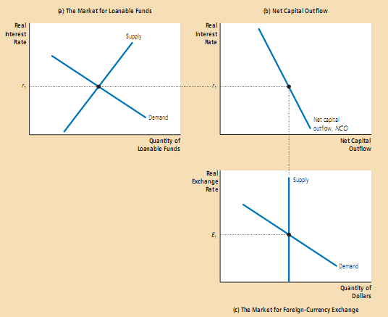
13.Simultaneous Equilibrium in Two Markets

Slide 14
14.The effects of a government budget deficit
(a) The Market for Loanable Funds
(b) Net Capital Outflow
Real
Interest
Rate
1. A budget deficit reduces
the supply of loanable funds . . .
Real
Interest
Rate
S₂
S₁
r₂
r₂
3. . . . which in
turn reduces
net capital
outflow.
B
A
r₁
r₁
2. . . .
which
increases
the real
interest
rate . . .
Demand
NCO
Quantity of
Loanable Funds
Net capital outflow
When the government runs a budget deficit, it reduces the supply of loanable funds from S₁ to S₂ in panel (a). The interest rate rises from r₁ to r₂ to balance the supply and demand for loanable funds. In panel (b), the higher interest rate reduces net capital outflow. Reduced net capital outflow, in turn, reduces the supply of dollars in the market for foreign-currency exchange from S₁ to S₂ in panel (c). This fall in the supply of dollars causes the real exchange rate to appreciate from E₁ to E₂. The appreciation of the exchange rate pushes the trade balance toward deficit.
Real
Exchange
Rate
S₂
S₁
4. The decrease
in net capital
outflow reduces
the supply of dollars
to be exchanged
into foreign
currency . . .
E₂
E₁
5. . . . Which causes the real exchange rate to appreciate.
Demand
Quantity of Dollars
(c) The Market for Foreign-Currency Exchange
<номер>

Slide 15
ACTIVE LEARNING ₃
Answers
Market for foreign-currency exchange
The fall in NCO reduces the
supply of dollars
in the foreign exchange market.
The real exchange
rate appreciates,
reducing net exports.
S₂ = NCO₂
E
S₁ = NCO₁
E₂
E₁
D = NX
Dollars
© 2012 Cengage Learning. All Rights Reserved. May not be copied, scanned, or duplicated, in whole or in part, except for use as permitted in a license distributed with a certain product or service or otherwise on a password-protected website for classroom use.
Notes:
<номер>

Slide 16
Budget Deficit vs. Investment Incentives
A tax incentive for investment has similar effects as a budget deficit:
  r rises, NCO falls
  E rises, NX falls
But one important difference:
  Effective Investment tax incentive increases investment, which increases productivity growth and living standards in the long run.
  Budget deficit reduces investment,
  which reduces productivity growth and living standards.
Notes:
<номер>
<номер>

Slide 17
Trade Policy
Trade policy:
a govt policy that directly influences the quantity of g&s that a country imports or exports
Examples:
  Tariff – a tax on imports
  Import quota – a limit on the quantity of imports
  “Voluntary export restrictions” – the govt pressures another country to restrict its exports; essentially the same as an import quota
Notes:
<номер>
<номер>

Slide 18
Trade Policy
Common reasons for policies that restrict imports:
  Save jobs in a domestic industry that has difficulty competing with imports
  Reduce the trade deficit
Do such trade policies accomplish these goals?
Let’s use our model to analyze the effects of
an import quota on cars from Japan
designed to save jobs in the U.S. auto industry.
Notes:
<номер>
<номер>

Slide 19
Analysis of a Quota on Cars from Japan
An import quota does not affect saving or investment,
so it does not affect NCO. (Recall: NCO = S – I.)
Loanable funds
Net capital outflow
r
r
S
r₁
r₁
D
NCO
LF
NCO
Notes:
<номер>
<номер>

Slide 20
Analysis of a Quota on Cars from Japan
Since NCO unchanged, S curve does not shift.
The D curve shifts:
At each E,
imports of cars fall,
so net exports rise,
D shifts to the right.
At E₁, there is excess demand in the foreign exchange market.
E rises to restore eq’m.
Market for foreign-currency exchange
E
S = NCO
E₂
E₁
D₂
D₁
Dollars
Notes:
<номер>
<номер>

Slide 21
Analysis of a Quota on Cars from Japan
What happens to NX? Nothing!
If E could remain at E₁, NX would rise, and the quantity of dollars demanded would rise.
But the import quota does not affect NCO,
so the quantity of dollars supplied is fixed.
Since NX must equal NCO, E must rise enough to keep NX at its original level.
Hence, the policy of restricting imports
does not reduce the trade deficit.
Notes:
<номер>
<номер>

Slide 22
Analysis of a Quota on Cars from Japan
Does the policy save jobs?
The quota reduces imports of Japanese autos.
  U.S. consumers buy more U.S. autos.
  U.S. automakers hire more workers to produce these extra cars.
  So the policy saves jobs in the U.S. auto industry.
But E rises, reducing foreign demand for U.S. exports.
  Export industries contract, exporting firms lay off workers.
The import quota saves jobs in the auto industry
but destroys jobs in U.S. export industries!!
Notes:
<номер>
<номер>

Slide 23
CASE STUDY: Capital Flows from China
In recent years, China has accumulated U.S. assets to reduce its exchange rate and boost its exports.
Results in U.S.:
  Appreciation of $ relative to Chinese renminbi
  Higher U.S. imports from China
  Larger U.S. trade deficit
Some U.S. politicians want China to stop,
argue for restricting trade with China to protect
some U.S. industries.
Yet, U.S. consumers benefit, and the net effect of China’s currency intervention is probably small.
Notes:
<номер>

Slide 24
Political Instability and Capital Flight
1994: Political instability in Mexico made world financial markets nervous.
  People worried about the safety of Mexican assets they owned.
  People sold many of these assets, pulled their capital out of Mexico.
Capital flight: a large and sudden reduction in the demand for assets located in a country
We analyze this using our model, but from the perspective of Mexico, not the U.S.
Notes:
<номер>
<номер>

Slide 25
Capital Flight from Mexico
The equilibrium values of r and NCO both increase.
Demand for LF = I + NCO.
The increase in NCO increases demand for LF.
As foreign investors sell their assets and pull out their capital, NCO increases at each value of r.
Loanable funds
Net capital outflow
r
r
S₁
r₂
r₂
r₁
r₁
NCO₂
D₂
D₁
NCO₁
LF
NCO
Notes:
<номер>
<номер>

Slide 26
Capital Flight from Mexico
Market for foreign-currency exchange
The increase in NCO causes an increase in the supply of pesos in the foreign exchange market.
The real exchange rate value of the peso falls.
E
S₁ = NCO₁
S₂ = NCO₂
E₁
E₂
D₁
Pesos
Notes:
<номер>
<номер>

Slide 27
Examples of Capital Flight: Mexico, 1994
Notes:
<номер>
<номер>

Slide 28
Examples of Capital Flight: S.E. Asia, 1997
Notes:
<номер>
<номер>

Slide 29
Examples of Capital Flight: Russia, 1998
Notes:
<номер>
<номер>

Slide 30
Examples of Capital Flight: Argentina, 2002
Notes:
<номер>
<номер>

Slide 31
CONCLUSION
The U.S. economy is becoming increasingly open:
  Trade in g&s is rising relative to GDP.
  Increasingly, people hold international assets in their portfolios and firms finance investment with foreign capital.
Notes:
<номер>
<номер>

Slide 32
CONCLUSION
Yet, we should be careful not to blame our problems on the international economy.
  Our trade deficit is not caused by
  other countries’ “unfair” trade practices,
  but by our own low saving.
  Stagnant living standards are not caused by imports, but by low productivity growth.
When politicians and commentators
discuss international trade and finance,
the lessons of this and the preceding chapter
can help separate myth from reality.
Notes:
<номер>
<номер>

Slide 33
SUMMARY
In an open economy, the real interest rate adjusts to balance the supply of loanable funds (saving) with the demand for loanable funds (domestic investment and net capital outflow).
In the market for foreign-currency exchange,
the real exchange rate adjusts to balance the supply of dollars (net capital outflow) with the demand for dollars (net exports).
Net capital outflow is the variable that connects these markets.
© 2012 Cengage Learning. All Rights Reserved. May not be copied, scanned, or duplicated, in whole or in part, except for use as permitted in a license distributed with a certain product or service or otherwise on a password-protected website for classroom use.
Notes:
<номер>

Slide 34
SUMMARY
A budget deficit reduces national saving, drives up interest rates, reduces net capital outflow, reduces the supply of dollars in the foreign exchange market, appreciates the exchange rate, and reduces net exports.
A policy that restricts imports does not affect net capital outflow, so it cannot affect net exports or improve a country’s trade deficit. Instead, it drives up the exchange rate and reduces exports as well as imports.
© 2012 Cengage Learning. All Rights Reserved. May not be copied, scanned, or duplicated, in whole or in part, except for use as permitted in a license distributed with a certain product or service or otherwise on a password-protected website for classroom use.
Notes:
<номер>

Slide 35
SUMMARY
Political instability may cause capital flight,
as nervous investors sell assets and pull their capital out of the country. As a result, interest rates rise and the country’s exchange rate falls. This occurred in Mexico in 1994 and in other countries more recently.
© 2012 Cengage Learning. All Rights Reserved. May not be copied, scanned, or duplicated, in whole or in part, except for use as permitted in a license distributed with a certain product or service or otherwise on a password-protected website for classroom use.
Notes:
<номер>

