Slide 1
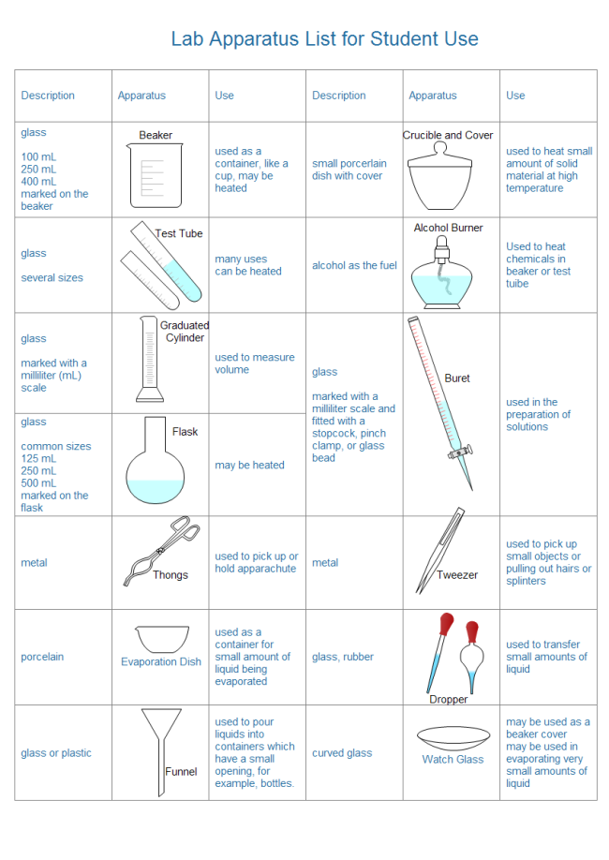
Scientific and professional terminology in the field of chemistry: chemical utensils, devices

Slide 3
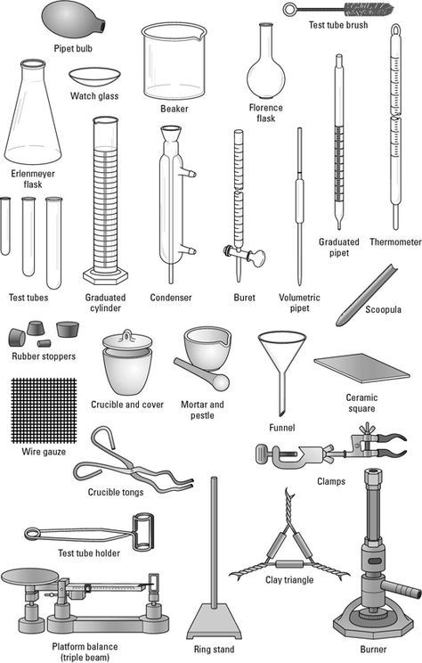

Slide 4
