Slide 1
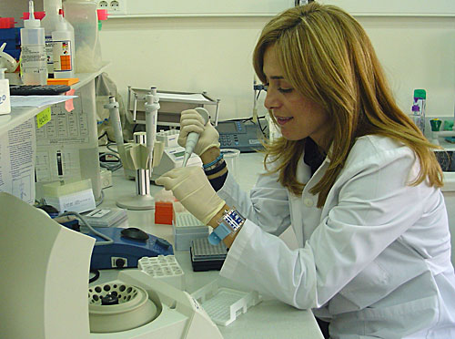
Antigen and Antibody Reactions
Detection By
Precipitation Methods
Dr.T.V.Rao MD

Slide 2
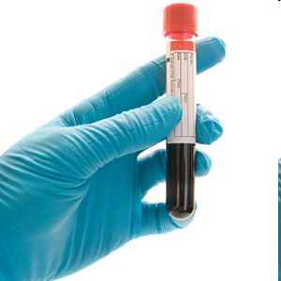
Beginning of Serology
Serology as a science began in 1901. Austrian American immunologist Karl Landsteiner (1868-1943) identified groups of red blood cells as A, B, and O. From that discovery came the recognition that cells of all types, including blood cells, cells of the body, and microorganisms carry proteins and other molecules on their surface that are recognized by cells of the immune system.

Slide 3
Characteristics of Antigens
Immunogenicity – property of substance (immunogens or antigens) to induce a detectable immune response
Antigenic specificity – property of antigen molecule (or its part) to react with the specific antibody.
Antigenicity – given by a surface structure of immunogen - antigenic determinants. The organism responds only to those that are foreign to him.
The number of antigenic determinants – usually varies with the size and chemical complexity of macromolecule (egg ovalbumin, MW 42 000, has 5 antigenic determinants and thyroglobulin, MW 700 000, has many as 40).

Slide 4
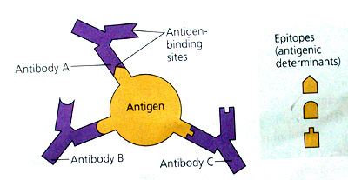
Characteristics of Antigens
Chemical nature of antigens:
  proteins
  polysaccharides
  lipopolysaccharides
  nucleoproteins
  glycoproteins
  steroid hormones
  bacterial cells, viruses
  synthetic polypeptides
  synthetic polymers

Slide 5
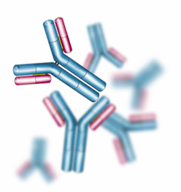
Characteristics of Antibodies (Immunoglobulins)
Proteins with the property of specific combination with antigen (or one antigenic determinant) which elicited their formation.
Immunoglobulin's account for ~ 20% of the total plasma proteins.

Slide 6

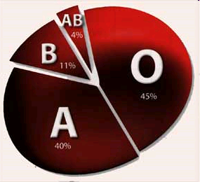
Karl Landsteiner (1868-1943)
An Austrian physician by training, Landsteiner played an integral part in the identification of blood groups. He demonstrated the catastrophic effect of transfusing with the wrong type of blood,

Slide 7
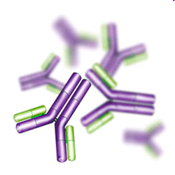
Purpose of Serological Tests
Serological tests may be performed for diagnostic purposes when an infection is suspected, in rheumatic illnesses, and in many other situations, such as checking an individual's blood type. Serology blood tests help to diagnose patients with certain immune deficiencies associated with the lack of antibodies, such as X-linked agammaglobulinemia.

Slide 8
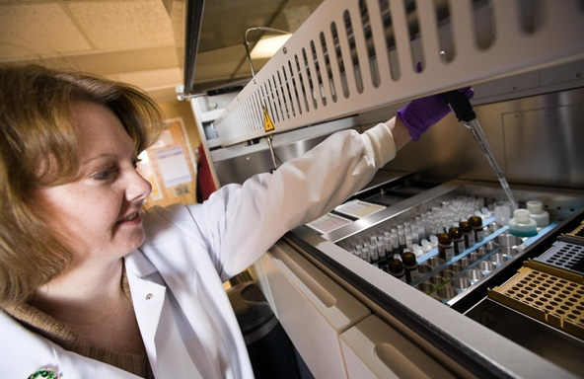
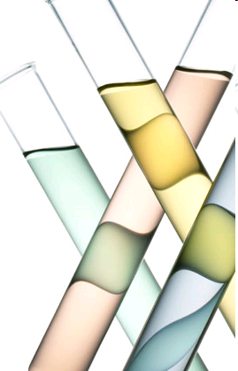
Serology
The branch of laboratory medicine that studies blood serum for evidence of infection and other parameters by evaluating antigen-antibody reactions in vitro

Slide 9
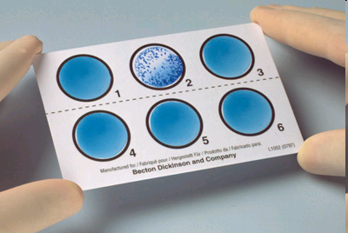
Serology
Serology is the scientific study of blood serum. In practice, the term usually refers to the diagnostic identification of antibodies in the serum
We can detect antigens too

Slide 10
Serology Prerogative of Microbiology
It is rather curious that, although serum for a multitude of constituents in biochemistry and haematological laboratories, the term serology has come to imply almost exclusively the detection of antibodies in serum for antibodies in infectious diseases, and terminology has become prerogative of microbiologists.

Slide 11
Immunological Tests
A harmful agent can be detected
  Toxins, viruses, hard to culture bacteria
  Takes advantage of the specific nature of antibodies
Rise in amount of antibody is an indicator
  An increase in specific antibody is an indicator of exposure, can confirm a diagnosis.
Antibodies bind, precipitate, and agglutinate.

Slide 12
Precipitation tests
When sufficient antigen and antibody molecules interact, they precipitate out of solution
  Too few antigen molecules, little ppt.
  Too many, agn-aby cross links not made.
Examples
  immunodiffusion: antibody and antigen react in agar to make ppt band or ring.
  Immunoelectrophoresis: complex mixture of antigens separated, then reacted with antibody.

Slide 13
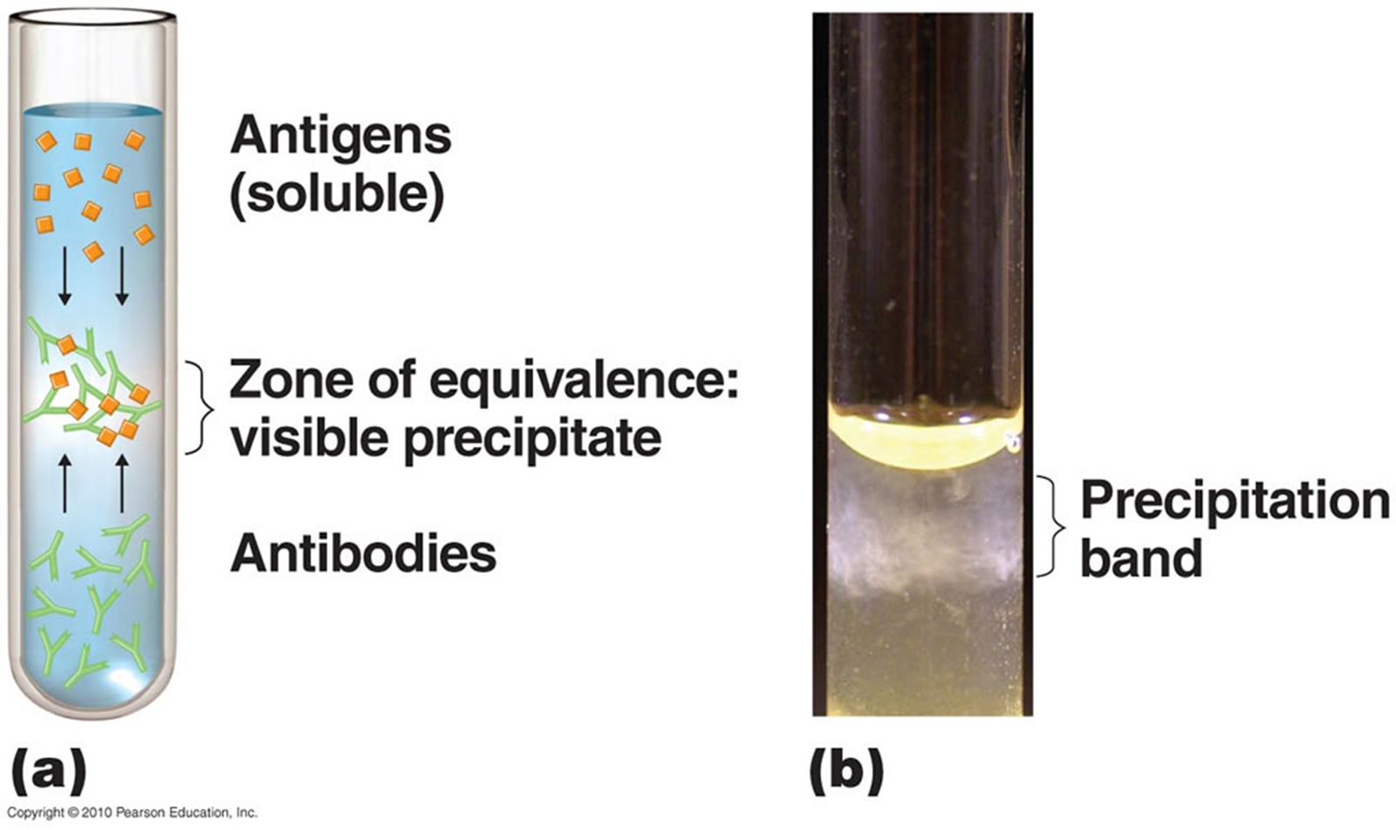
Precipitation Reaction as happens in VITRO

Slide 14
Immunology/ Serology?
Precipitation Reactions
Capillary tube precipitation (Ring Test)
Ouchterlony Double Diffusion (Immunodiffusion)
Radialimmunodiffusion (RID)
Immunoelectrophoresis (IEP)
Rocket Electroimmunodiffusion (EID)
Counterimmunoelectrophoresis (CIEP)
The above tests have moved to Biochemistry

Slide 15
Terms used in evaluating test methodology
Sensitivity
  Analytical Sensitivity – ability of a test to detect very small amounts of a substance
  Clinical Sensitivity – ability of test to give positive result if patient has the disease (no false negative results)

Slide 16
Specificity
Analytical Specificity – ability of test to detect substance without interference from cross-reacting substances
Clinical Specificity – ability of test to give negative result if patient does not have disease (no false positive results)

Slide 17
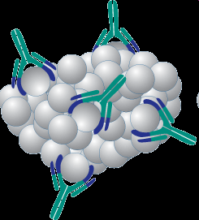
Affinity
Affinity refers to the strength of binding between a single antigenic determinant and an individual antibody combining site.
Affinity is the equilibrium constant that describes the antigen-antibody reaction

Slide 18
Affinity
Antibody affinity is the strength of the reaction between a single antigenic determinant and a single combining site on the antibody.
It is the sum of the attractive and repulsive forces operating between the antigenic determinant and the combining site .

Slide 19
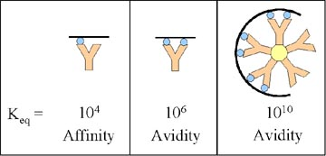
Avidity
Avidity is a measure of the overall strength of binding of an antigen with many antigenic determinants and multivalent antibodies
Avidity is influenced by both the valence of the antibody and the valence of the antigen.
Avidity is more than the sum of the individual affinities.

Slide 20
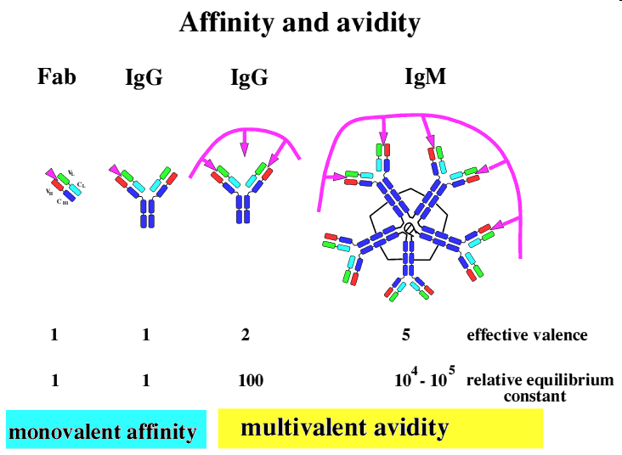

Slide 21
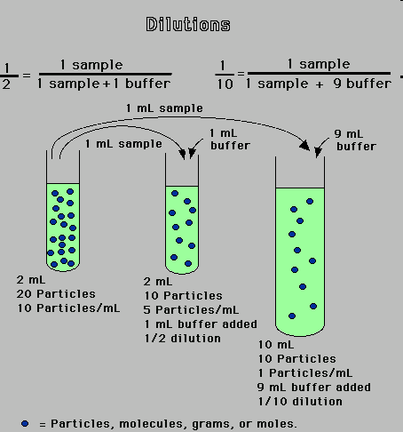
Dilution
Estimating the antibody by determining the greatest degree to which the serum may be diluted without losing the power to given an observable effect in a mixture with specific antigen

Slide 22
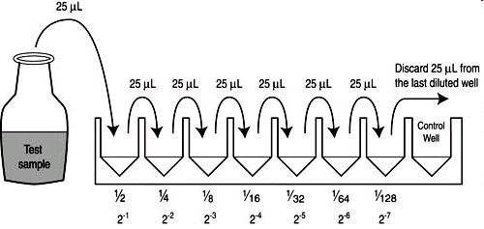
Titer
Different dilutions of serum are tested in mixture with a constant amount of antigen and greatest reacting dilution is taken as the measure or Titer

Slide 23
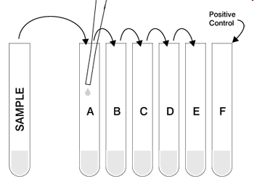
Expression of Titers
Expressed in term of the was in which they are made
Dilution 1 in 8 is a dilution made by mixing one volume of serum with seven volumes of diluents (Normal Saline )
Incorrect to express dilution as 1/8

Slide 24
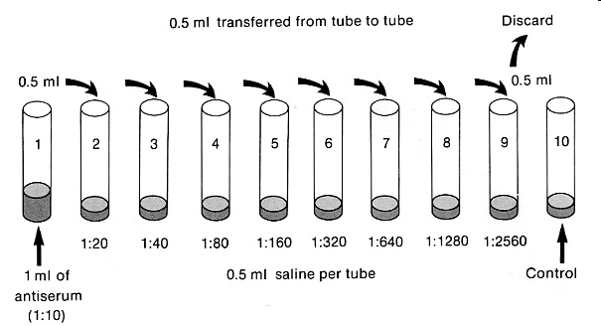
Common methods in creating dilutions

Slide 25
Characteristics of Antibodies are Variable (Immunoglobulins)
Variability of antibodies is subject to 5-classes of Ig: G, A, M, D, E
Heavy chains – γ, α, μ, δ, ε
Light chains – κ, λ
Subclasses of immunoglobulins:
  IgG – γ₁, γ₂, γ₃, γ₄
  IgA – α₁, α₂
  IgM - μ₁, μ₂

Slide 26
The forces binding antigen to antibody
Electrostatic : between attraction oppositely charged ionic group – (-NH₃⁻) of lysine and (-COO⁻) of aspartate.
Hydrogen bonding – relatively weak and reversible hydrogen bridges between hydrophilic group (-OH, -NH₂, COOH).
Hydrophobic– non-polar, hydrophobic side chains of Val, Leu, Ile (hydrophobic groups come close together and exclude water molecules between them. The force of attraction increases.
Van der Waals – forces which depend upon interaction between the external „electron clouds“. Non-specific attractive forces.

Slide 27
Antibody Affinity
k₂
Ab + Ag  AbAg
k₁
K = =
[AbAg]
k₁
k₂
Equilibrium constant
[Ab] [Ag]

Slide 28
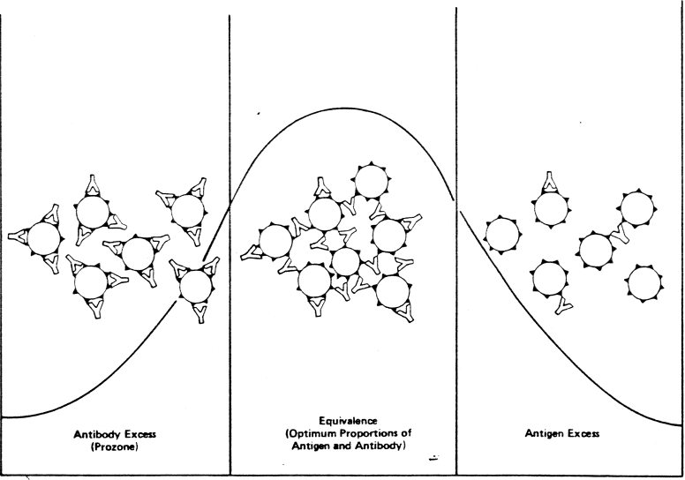
The ratio of antigen / antibody
Prozone : Ab excess, precipitate does not form ( (soluble immune complexes)
Zone of equivalence- optimal ratio of Ag/Ab – insoluble precipitate
Post-zone – excess of Ag (soluble immune complexes)

Slide 29
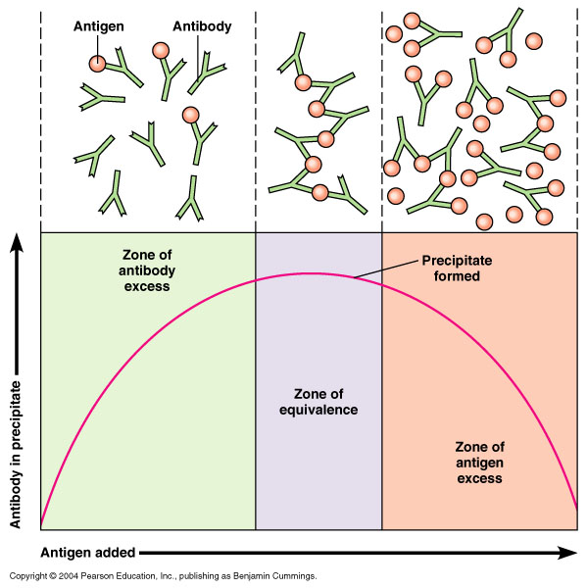
Precipitation Curve

Slide 30
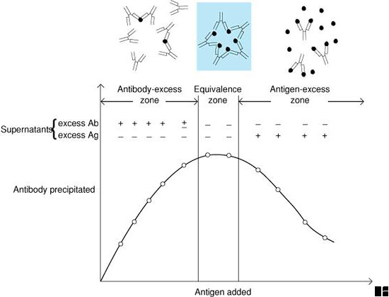
Precipitation Curve

Slide 31
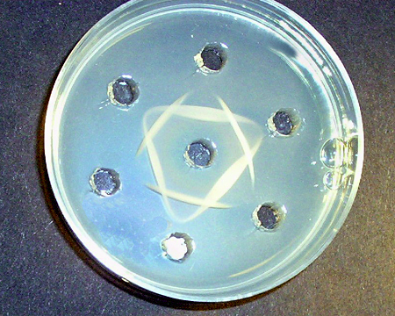
Precipitation Reactions
Ag-Ab interactions can form visible precipitate
  Examples:
    Radial immunodiffusion
    Double immunodiffusion
    immunoelectrophoresis

Slide 32
Precipitation
Principle
  Soluble antigen + antibody (in proper proportions) –> visible precipitate
  Lattice formation (antigen binds with Fab sites of 2 antibodies)
Examples
  Double diffusion (Ouchterlony)
  Single diffusion (radial Immunodiffusion)
  Immunoelectrophoresis
  Immunofixation

Slide 33
Precipitation in gels
Based on different rates of diffusion of Ag and Ab into the gel, depending on their :
concentration
physicochemical properties
gel structure
Most widely used gels – agar a agarose
Tests are performed by pouring molten agar (agarose) onto glass slides

Slide 34
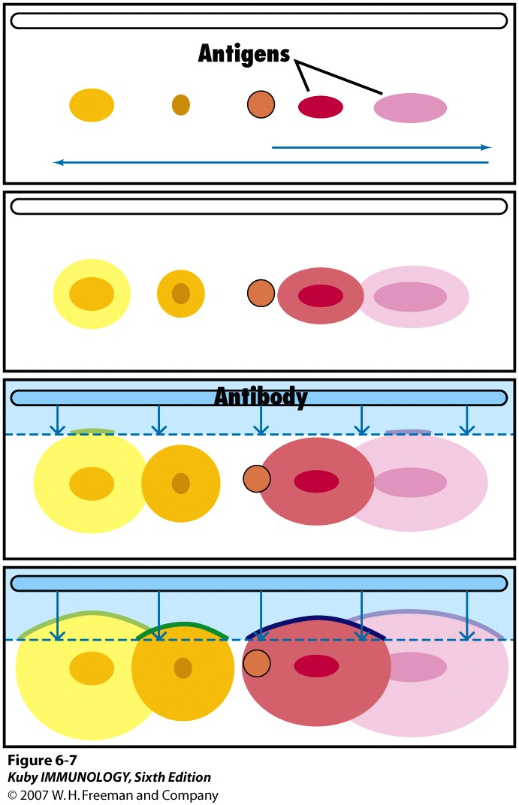
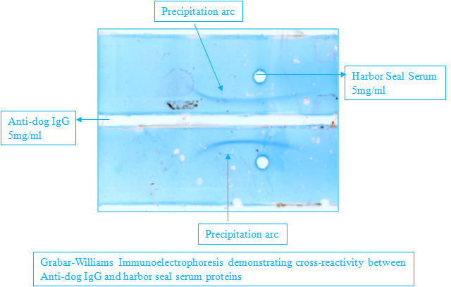
Immunoelectrophoresis –
Antigen is 1st put into wells,
charge is applied to separate
components of antigen mixture,
then troughs are cut and antibody
is allowed to diffuse
through gel

Slide 35
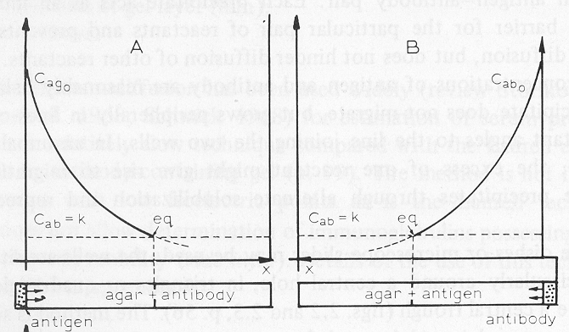
Precipitation and Immunodiffusion in gels
Single (simple) diffusion in one dimension:
- the process of diffusion of an antigen in an antibody-containing gel
- the process of diffusion of an antibody in an antigen-containing gel.
Immunoprecipitin line is formed at the point of equivalence.

Slide 36
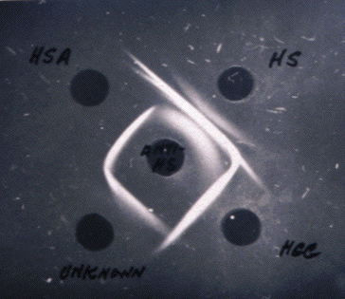
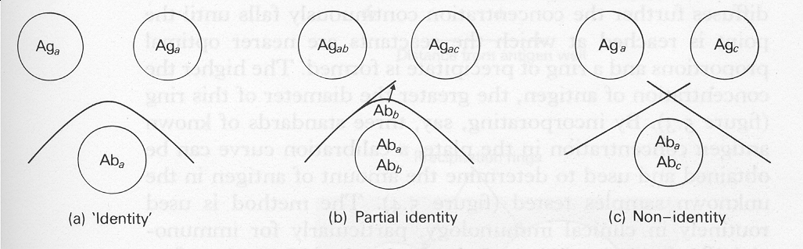
Precipitation and Immunodiffusion in Gels
Double diffusion in two dimension
Similar precipitin lines
Precipitin lines do not form a complete cross
Precipitin lines completely cross

Slide 37
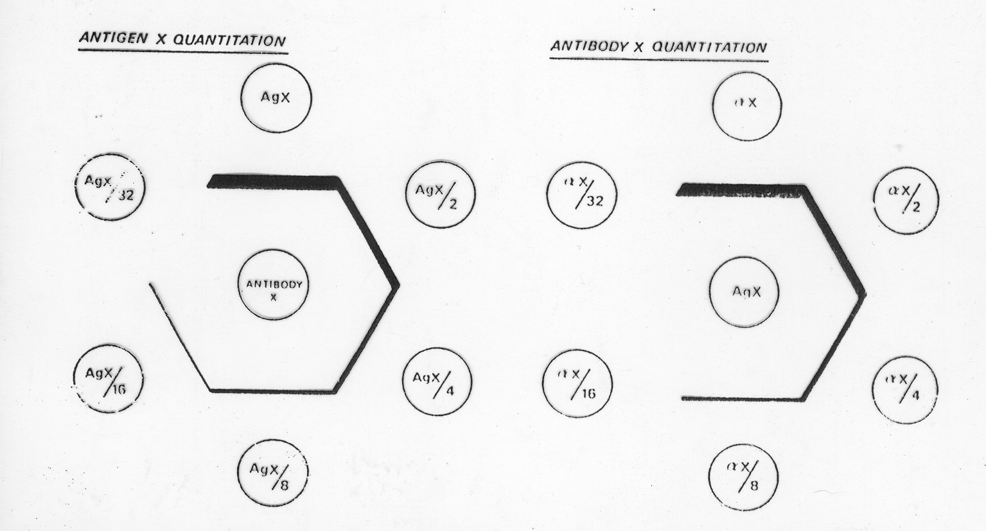
Precipitation and Immunodiffusion in gels
Semiquantitative analysis of:
antigen antibody

Slide 38
Precipitation and immunodiffusion in gels
Double diffusion is utilized as a rough estimation of antigen or antibody purity.
Double diffusion in agar can be used for semi quantitative analysis in human serological system.

Slide 39
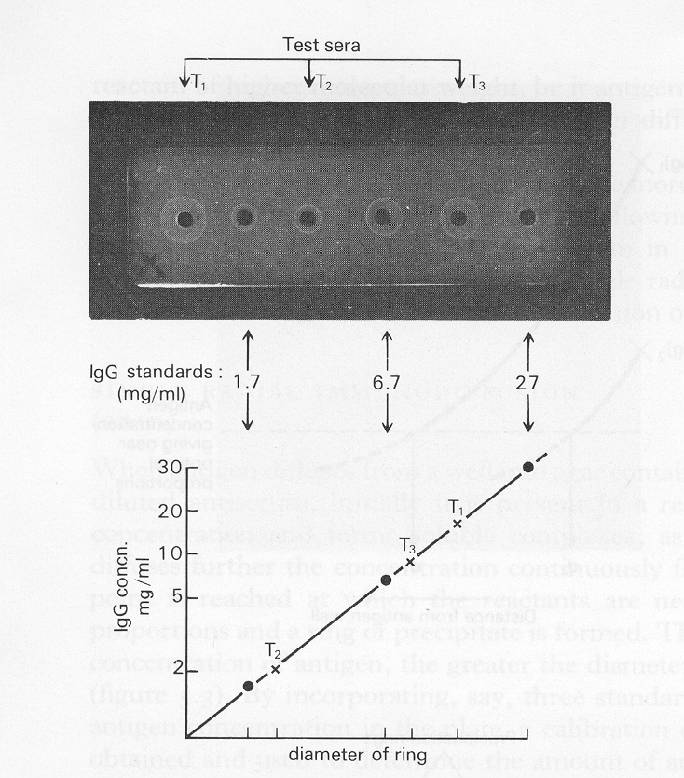
Precipitation and Immunodiffusion in gels
Single radial diffusion – quantitative analysis

Slide 40
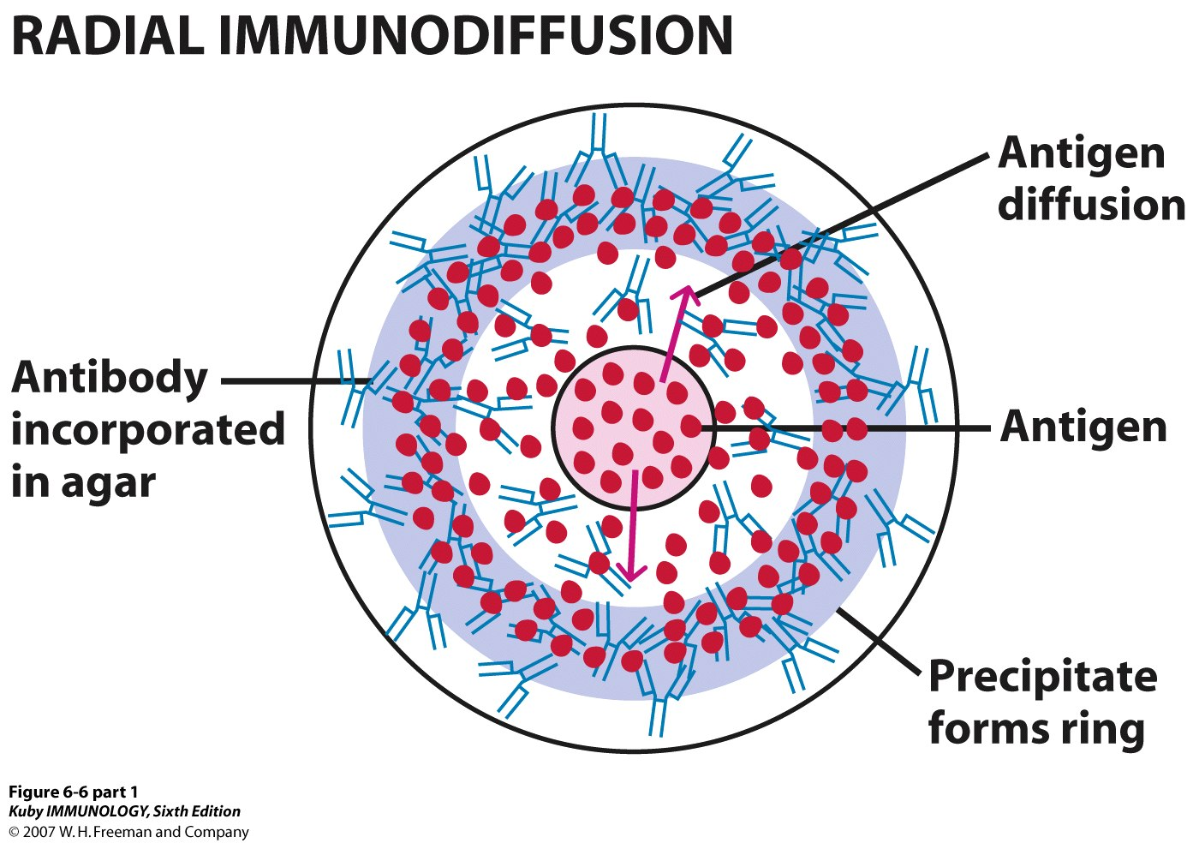
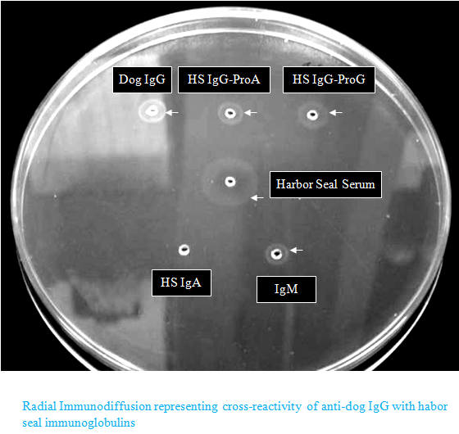
In this example, Anti-dog IgG is
Mixed in agar so only what is
Placed in wells (Ag) diffuses out

Slide 41
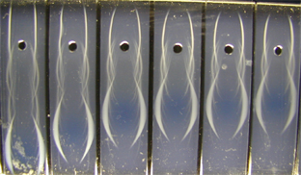
Immunoelectrophoresis

Slide 42
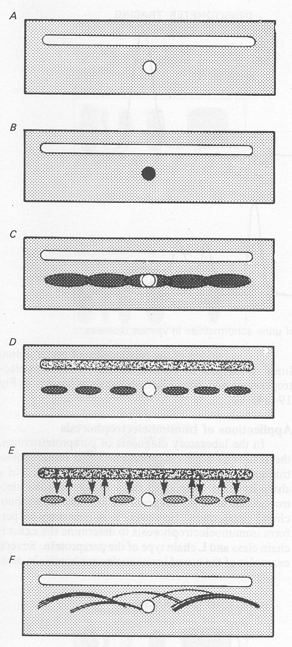
Precipitation and Immunodiffusion in gels
Immunoelectrophoresis combines electrophoresis separation, diffusion and precipitation of proteins.
Plasma (mixture of antigens)
Electrophoresis
Antiserum (mixture of antibodies)
Imunodiffusion

Slide 43
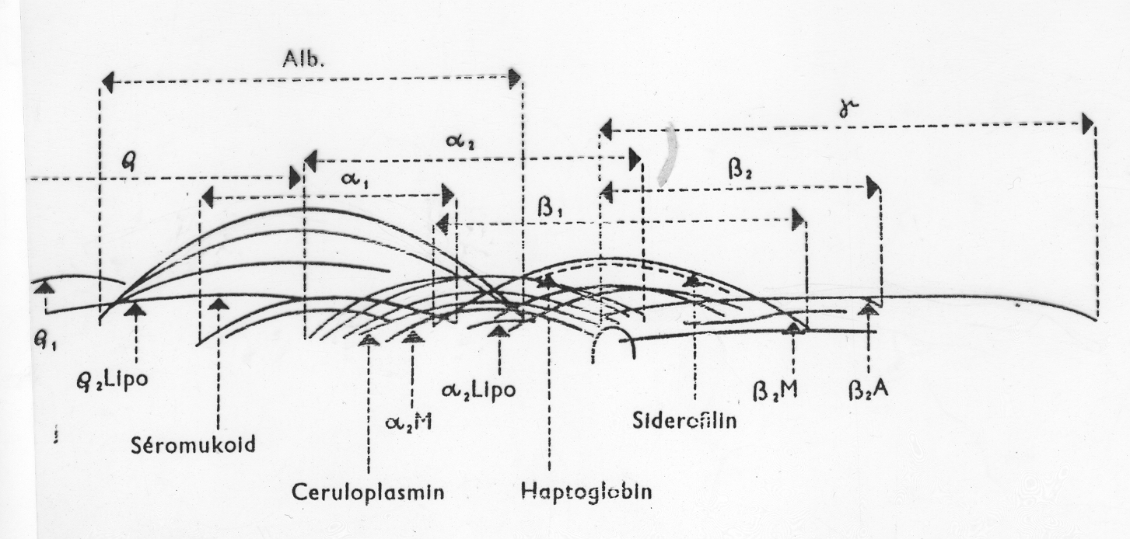
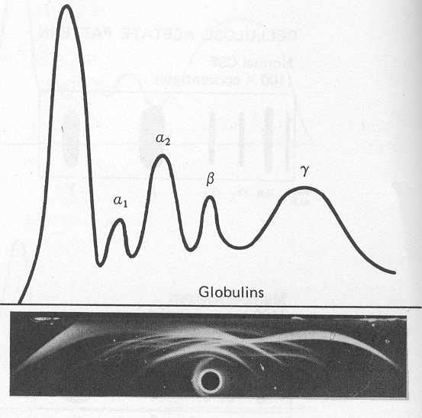
Precipitation and Immunodiffusion in gels

Slide 44
Antigen and Antibody reactions can be identified by different methods

Slide 45
Precipitation test
Radial Immunodiffusion (Mancini) –
In radial Immunodiffusion Antigen (IgG antibody) is incorporated into the agar gel as it is poured
different dilutions of the antibody are placed in holes punched into the agar.
As the antibody diffuses into the gel it reacts with the antigen and when the equivalence point is reached a ring of precipitation is formed as illustrated in Figure
The diameter of the ring is proportional to the concentration of antibody since the amount of antigen is constant.

Slide 46
Radial Immunodiffusion (Mancini)
Thus, by running different concentrations of a standard antibody one can generate a standard cure from which one can quantitate the amount of an antibody in an unknown sample.
Thus, this is a quantitative test.
If more than one ring appears in the test, more than one antigen/antibody reaction has occurred. This could be due to a mixture of antigens or antibodies.
This test is commonly used in the clinical laboratory for the determination of immunoglobulin levels in patient samples.

Slide 47
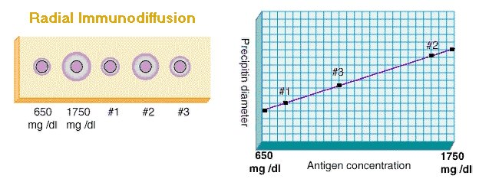

Slide 48
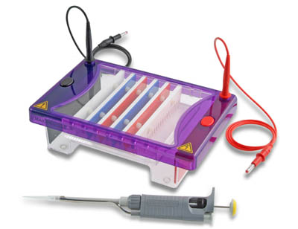
Electrophoresis

Slide 49
Electrophoresis
Electrophoresis
The migration of particles under the influence of a direct electrical current,
and requires
Charged particles
Medium capable of carrying a current

Slide 50
What we Need for electrophoresis Factors
pH
Ionic strength
Choice of electrolyte
Electrophoretic conditions
Choice of support
Voltage
Current
Heat

Slide 51
Advantages of Electrophoresis
Ease of use
Properties affecting separation
Suitability for appropriate stains or other detection
Suitability for post electrophoretic data analysis

Slide 52
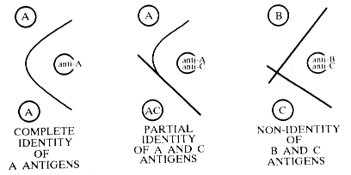
Double Immunodiffusion
Identification

Slide 53
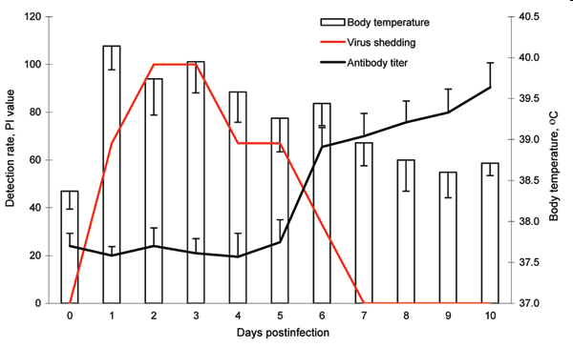
Sero Conversion
Seroconversion is the development of detectable specific antibodies to microorganisms in the blood serum as a result of infection or immunization.

Slide 54

Sero reversion
Seroreversion is the opposite of seroconversion. This is when the tests can no longer detect antibodies or antigens in a patient’s serum

Slide 55
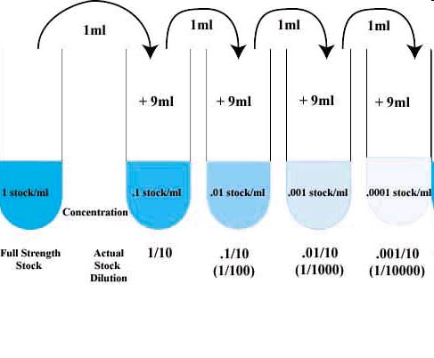
Testing paired Samples
Testing for infectious diseases is performed on acute and convalescent specimens (about 2 weeks apart) Paired sample.
Must see 4-fold or 2-tube rise in titre to be clinically significant

Slide 56
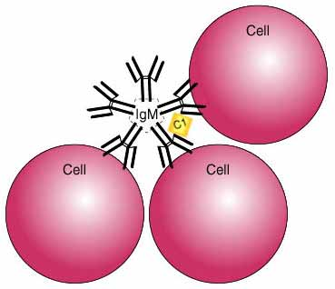
Antigen – Antibody Reactions presenting with precipitation

Slide 57
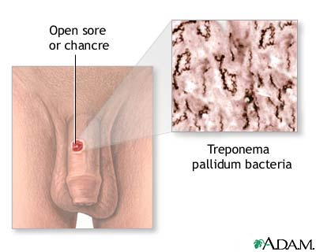
Screening Tests for Syphilis
Serologic methods are divided into two classes. One class, the nontreponemal tests, detects antibodies to lipoidal antigens present in either the host or T. palladium; examples are the Venereal Disease Research Laboratory and rapid plasma reagin and tests.

Slide 58
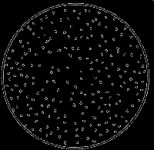
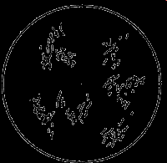
Non reactive and Reactive VDRL Tests

Slide 59
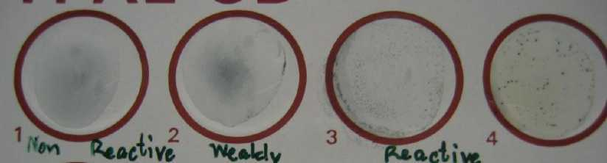
Flocculation test
(A precipitation reaction)
(1) Non Reactive (2) Weakly Reactive (3,4) Reactive
Notes:
Photo public domain

Slide 60
Measurement of Precipitation by Light
Antigen-antibody complexes, when formed at a high rate, will precipitate out of a solution resulting in a turbid or cloudy appearance.
Turbidimetry measures the turbidity or cloudiness of a solution by measuring amount of light directly passing through a solution.
Nephelometry indirect measurement, measures amount of light scattered by the antigen-antibody complexes.

Slide 61
Programme Created by Dr.T.V.Rao MD for Medical and Paramedical Students in the Developing World
Email
doctortvrao@gmail.com

