Slide 1
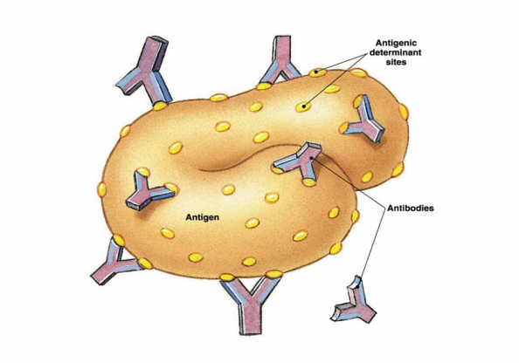
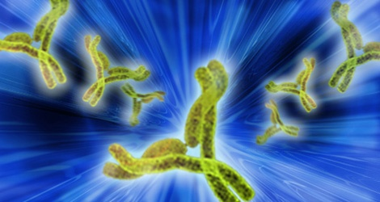
Antigen. Bacterial antigens. Major Histocompatibility Complex

Slide 2
The name antigens (Gk. anti against, genos genus) is given to organic substances of a colloid structure (proteins and different protein complexes in combination with lipids or polysaccharides) which upon injection into the body are capable of causing the production of antibodies and reacting specifically with them.

Slide 3
Antigens, consequently, are characterized by the following main properties:
(1) the ability to cause the production of antibodies (antigenicity), and
(2) the ability to enter into an interaction with the corresponding antibodies (antigenic specificity).

Slide 4
The features of molecules that determine antigenicity and immunogenicity are as follows.
A. Foreignness: In general, molecules recognized as "self” are not immunogenic; ie, we are tolerant to those self-molecules. To be immunogenic, molecules must be recognized as "nonself," ie, foreign.
B. Molecular Size: The most potent immunogens are proteins with high molecular weights, ie, above 100,000.
C. Chemical-Structural Complexity:
D. Antigenic Determinants (Epitopes): Epitopes are - small chemical groups on the antigen molecule that can elicit and react with antibody.
Most antigens have many determinants; ie, they are multivalent. In general, i determinant is roughly 5 amino acids or sugars in size. The overall three-dimensional structure is the main criterion of antigenic specificity.

Slide 5
Antigenic substances must have also certain properties: a colloid structure, and solubility in the body fluids.
Antigenic properties are pertinent to toxins of a plant origin (ricin, robin, abrin, cortin, etc.), toxins of an animal origin (toxins of snakes, spiders, scorpions, phalangia, karakurts, bees), enzymes, native foreign proteins, various cellular elements of tissues and organs, bacteria and their toxins, rickettsiae and viruses.

Slide 6
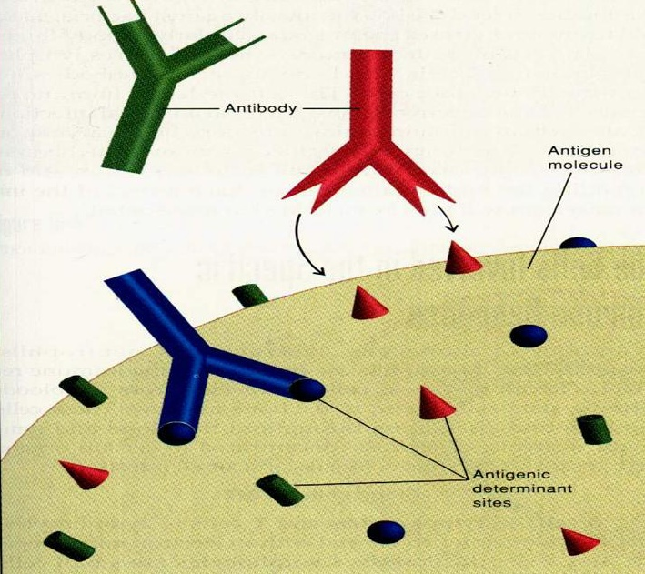

Slide 7
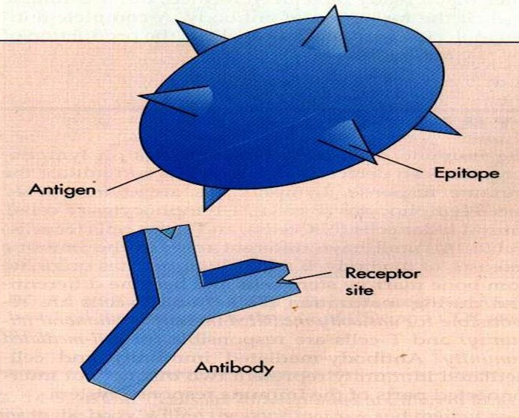

Slide 8


Slide 9
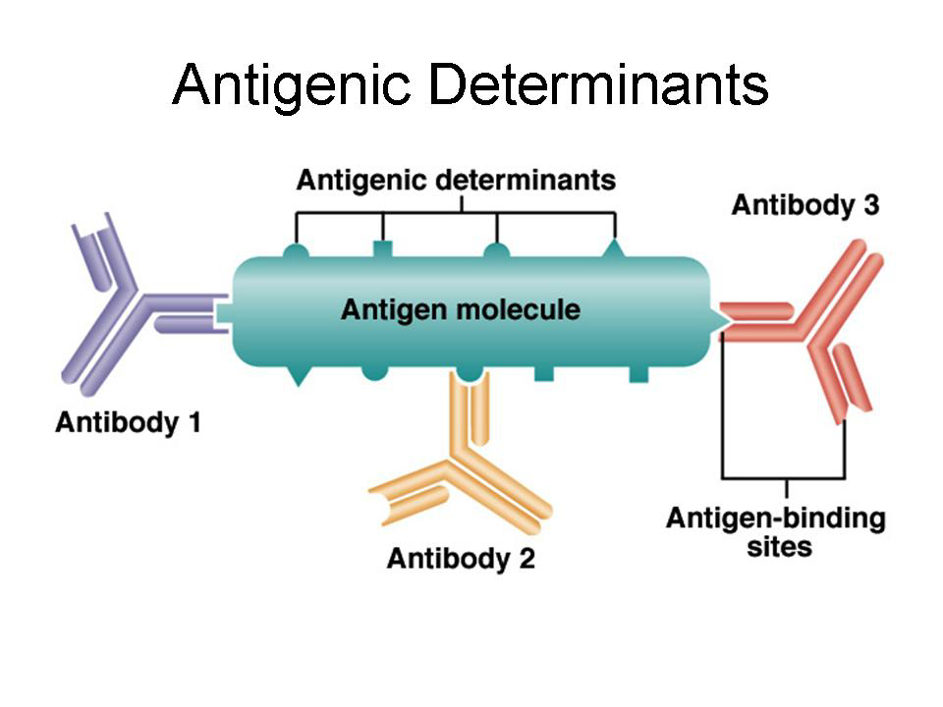

Slide 10
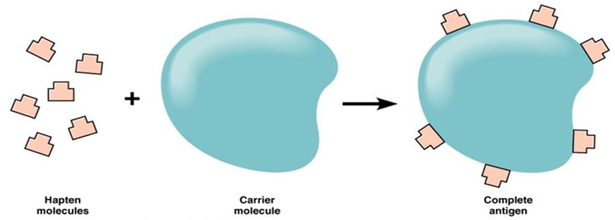
Hapten is a molecule that is not immunogenic by itself but can react with specific antibody. Haptens are usually small molecules, but some high-molecular-weight nucleic acids, lipids, complex carbohydrates and other substances are haptens as well. Many drugs, eg, penicillins, are haptens, and the catechol in the plant oil that causes poison oak and poison ivy is a hapten. The addition of proteins to haptens even in a small amount gives them the properties of complete antigens. In this case the protein carries out the function of a conductor.

Slide 11
Vi
O
K
H
Antigen structure of bacteria cell

Slide 12
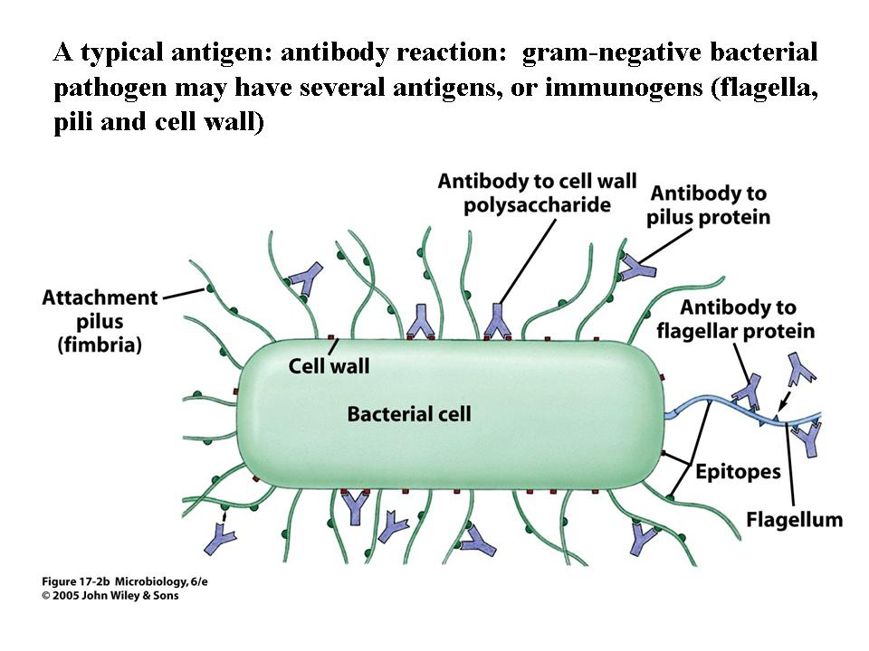

Slide 13
H
N
Antigens of influenca virus

Slide 14
Isoantigens. Isoantigens are those substances which have antigenic properties and are contained in some individuals of a given species. They have been found in the erythrocytes of animals and man.
On the basis of antigenic structure the erythrocytes of all people can be subdivided into 4 groups.

Slide 15
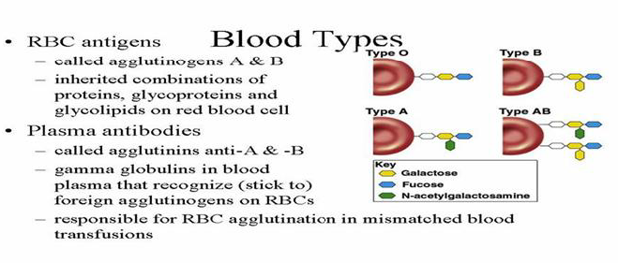

Slide 16
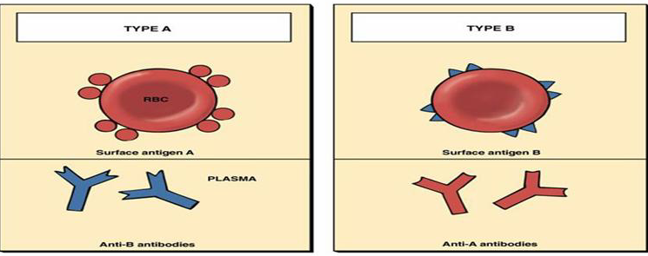

Slide 17
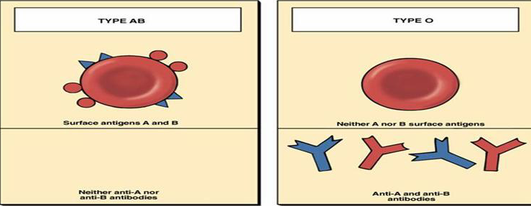

Slide 18
When the antigenic structures of the host are similar to those of the causative agent, the macroorganism is incapable of producing immunity, as the result of which the disease follows a graver course.
It is possible that in individual cases the carrier state and inefficacy of vaccination are due to the common character of the microbial antigens and the antigens of the person's cells.
It has been established that human erythrocytes have antigens in common with staphylococci, streptococci, the organisms of plague, E. coli. Salmonella paratyphi, Shigella organisms, smallpox and influenza viruses, and other causative agents of infectious diseases. Such a condition is called antigenic mimicry.

Slide 19
Autoantigens are substances capable of immunizing the body from which they are obtained.
These substances include
the eye lens,
spermatozoids,
homogenates ofthe thyroide, seminal gland,
skin, emulsions of kidneys,
liver, lungs and other tissues.
Under ordinary conditions they do not come in contact with the immunizing systems of the body, therefore antibodies are not produced against such cells and tissues. However, if these tissues are injured, then autoantigens may be absorbed, and may cause the production of antibodies which have a toxic effect on the corresponding cells.
The origination of autoantigens is possible under the influence of cooling, radiation, drugs (amidopyrine, sulphonamides, preparations of gold, etc.), virus infections "(virus pneumonias and mononucleosis), bacterial proteins and toxins of streptococci, staphylococci, tubercle bacilli, paraproteins, aseptic autolysis of brain tissue, and other factors.

Slide 20
Major histocompatibility complex
MHC complex
Collection of genes on chromosome 6
Three regions: class I, class II, class III
Highly polymorphic!
Gene products:
  class I molecules
  class II molecules
  class III molecules (and other stuff)

Slide 21
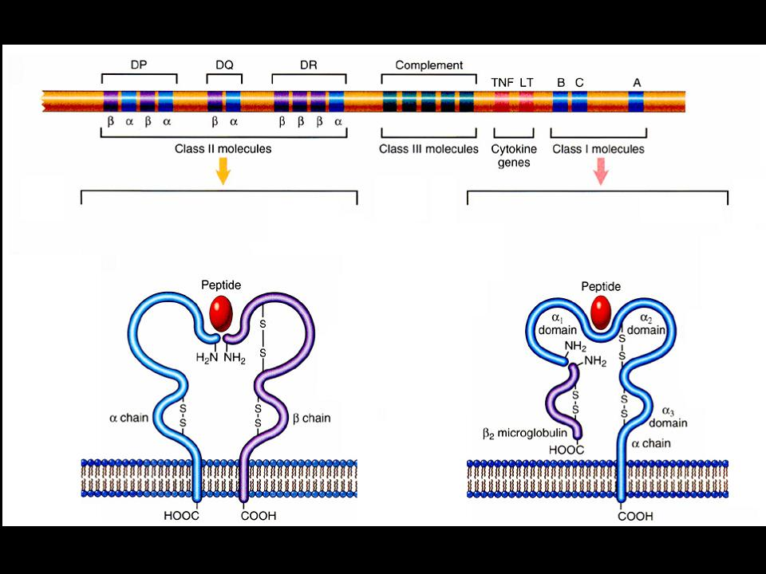
class II MHC genes
class III MHC genes
class I MHC genes
class II MHC molecule
class I MHC molecule

Slide 22
Class I MHC molecules
Encoded by three loci: HLA-A, HLA-B, HLA-C
Display antigens from within the cell (e.g., viral antigens)
to CD8+ T cells.
Present on all nucleated cells! (Good idea.)

Slide 23
Class II MHC molecules
Encoded by three loci: HLA-DP, HLA-DQ, HLA-DR
Display extracellular antigens (e.g., bacterial antigens the cell has eaten) to CD4+ T cells
Present mainly on antigen presenting cells, like macrophages! (Makes sense.)

Slide 24
There are many alleles of the class I and class II genes. For example, there are at least 47 HLA-A genes, 88 HLA-B genes, 29 HLA-C genes, and more than 300 HLA-D genes, but any individual inherits only a single allele at each locus from each parent and thus can make no more than two class I and tl proteins at each gene locus.
Expression of these genes is codominant, ie, the proteins encoded by both the paternal and maternal genes are produced. Each person can make as many as 12 HLA proteins: 3 at class I loci and 3 at class II loci, from both chromosomes.

Slide 25
BIOLOGIC IMPORTANCE OF MHC
The ability of T cells to recognize antigen is dependent on association of the antigen with either class 1 or class II proteins. For example, cytotoxic T cells respond to antigen in association with class 1 MHC proteins. Thus, a cytotoxic Tcell that kills a virus-infected cell will not kill a cell in­fected with the same virus if the cell does not also express the appropriate class 1 proteins.
MHC genes and proteins are also important in two other medical contexts. One is that many autoimmune diseases occur in people who carry certain MHC genes, and the other is that the success of organ transplants is, in large part, determined by the compatibility of the MHC genes of the donor and recipient.

Slide 26
Disease | HLA | Frequency of antigens at sick persons | of presence at healthy persons | Antigens on which the immune answer develops
Addison’s disease | DR5 | 70 | 20 | Adrenal cortex
Behtyer’s disease | B27 | 89 | 9 | Unknown
Hashimoto’s thyreoiditis | DR3, DR5 | 51 | 24 | Thyroglobulin
Juvenile diabetes | DR3, DR4 | 72 | 24 | Insulin receptor
Rheumatoid arthritis | DR7, DR21 | 59 | 21 | Colagen, Fc fragment of IgG
Narcolepsy | DR2 | 100 | 34 | Unknown
Goodpasture’s syndrom | DR2 | 88 | 29 | Basement membrane of a kidney and lung

Slide 27
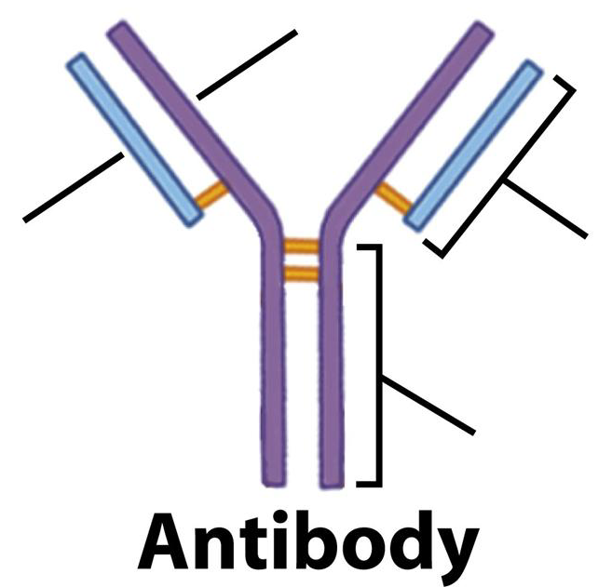
ANTIBODIES (IMMUNOGLOBULINS)
Antibodies are globulin proteins (immunoglobulins) that react specifically with the antigen that stimulated their production. They make up about 20% of the protein in blood plasma.. There are five classes of antibodies: IgG, IgM, IgA, IgD, and IgE.
IMMUNOGLOBULIN STRUCTURE
Immunoglobulins are glycoproteins made up of light (L) and heavy (H) polypeptide chains. The terms "light" and heavy" refer to molecular weight; The simplest antibody molecule has a Y shape and consists of four polypeptide chains: two H chains and two L chains. The four chains are linked by disulfide bonds. An individual antibody molecule always consists of identical H chains and identical L chains.

Slide 28
The Immune system includes 5 classes of Immunoglobulin (Ig)
Heavy (H) polypeptide chains | Class of immunoglobulin
γ | Ig G
μ | Ig M
α | Ig A
ε | Ig E
δ | Ig D
Ig G - γ₂λ₂,,γ₂κ₂
Ig M - (μ₂λ₂)_{5,} (μ₂κ₂)₅
Ig A - (α₂λ₂)_{n} , (α₂κ₂)_{n,,}
Ig E - ε₂λ₂, ε₂κ₂
IgD - δ₂λ₂, δ₂κ₂

Slide 29
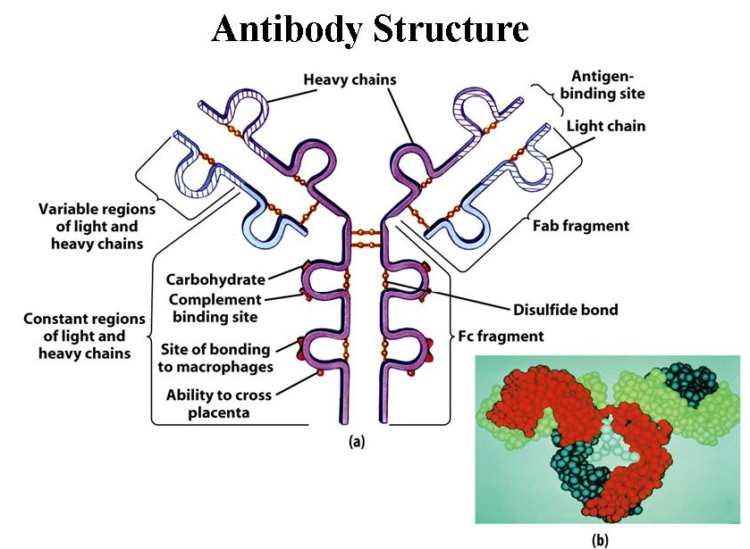
If an antibody molecule is treated with a proteolytic enzyme such as papain, peptide bonds in the "hinge" region are broken, producing two identical Fab fragments, which carry the antigen-binding sites, and one Fc fragment, which is involved in placenta! transfer, complement fixation, attachment site for various cells, and other biologic activities

Slide 30
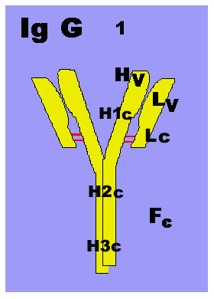
IgG. Each IgG molecule consists of two L chains and two H chains linked by disulfide bonds (molecular formula H2L2). Because it has two identical antigen-binding sites, it is said to be divalent.
IgG is the predominant antibody in the secondary-response and constitutes an important defense against bacteria and viruses. IgG is the only antibody to cross the placenta only its Fc portion binds to receptors on the surface of placental cells. It is therefore the most abundant immunoglobulin in newborn.
IgG is one of the two immunoglobulins that can activate complement and opsonizes.
IMMUNOGLOBULIN CLASSES

Slide 31
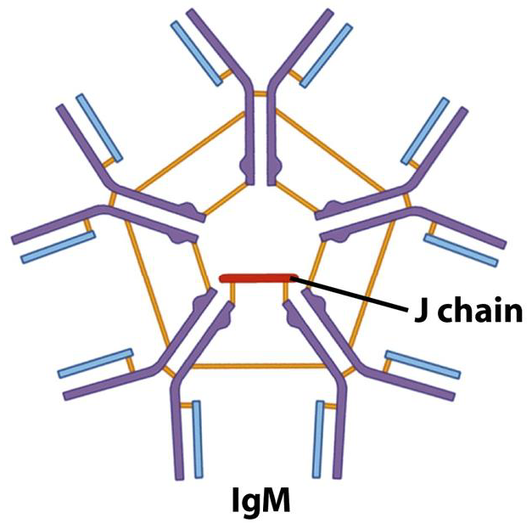
IgM is the main immunoglobulin produced early in the primary response. It is present as a monomer on the surface of virtually all B cells, where it functions as an antigen-binding receptor. In serum, it is a pentamer composed of 5 H2L2 units plus one molecule of J (joining) chain. Because the pentamer has 10 antigen-binding sites, it is the most efficient immunoglobulin in agglutination, complement fixation (activation), and other antibody reactions and is important in defense against bacteria and viruses. It can be produced by the fetus in certain infections. It has the highest avidity of the immunoglobulins; its interaction with antigen can involve all 10 of its binding sites.

Slide 32
IgA is the main immunoglobulin in secretions such as colostrum, saliva, tears, and respiratory, intestinal, and genital tract secretions. It prevents attachment of bacteria and viruses to mucous membranes. Each secretory IgA molecule consists of two H2L2 units plus one molecule each of J (joining) chain and secretory component. The secretory component is a polypeptide synthesized by epithelial cells that provides for IgA passage to the mucosal surface. It also pretects IgA from being degraded in the intestinal tract. In serum, some IgA exists as monomeric H2L2.

Slide 33
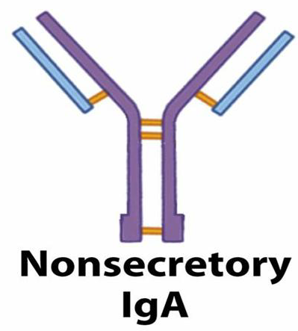
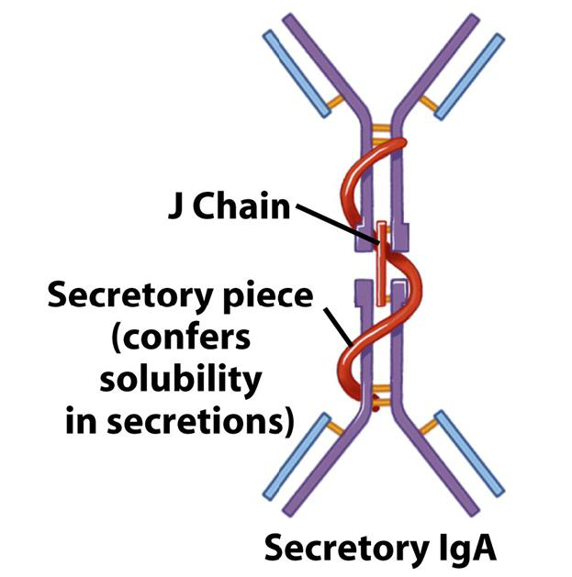

Slide 34
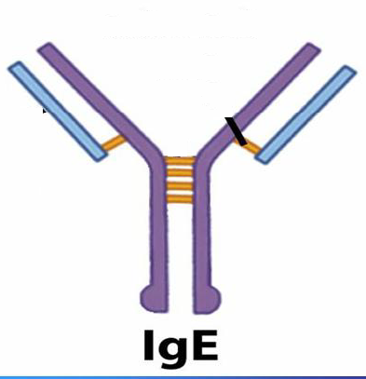
IgE is medically important for two reasons: (1) it mediates immediate (anaphylactic) hypersensitivity, and
(2) it participates in host defenses against certain parasites, eg, helminths (worms). The Fc region of IgE binds to the surface of mast cells and basophils. Although IgE is present in trace amounts in normal serum (approximately 0.004%), persons with allergic reactivity have greatly increased amounts, and IgE may appear in external secretions. IgE does not fix complement and does not cross the placenta.

Slide 35
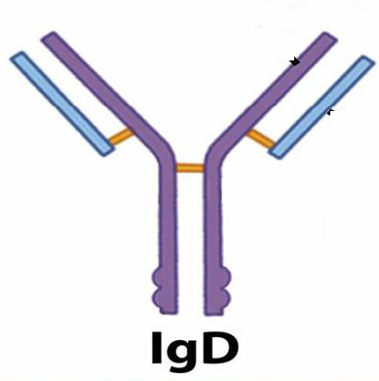
IgD. This immunoglobulin has no known antibody function but may function as an antigen receptor; it is present on the surface of many B lymphocytes. It is present in small amounts in serum.

Slide 36
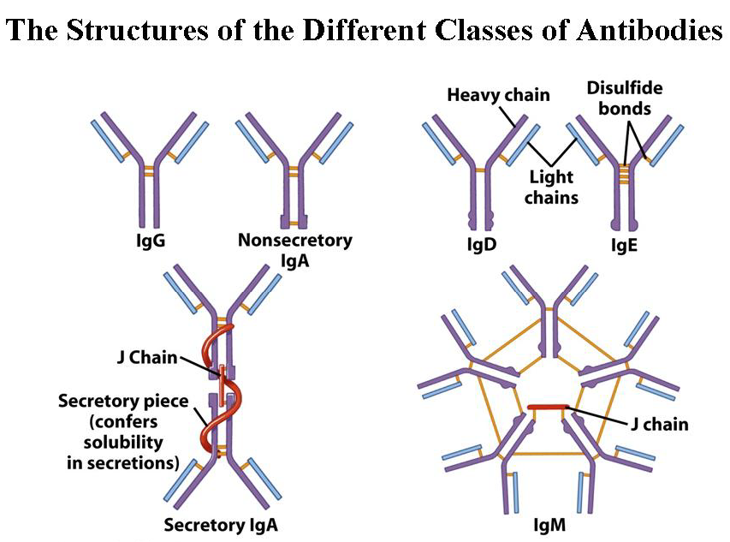

Slide 37
Major Functions of Human Immunoglobulins
Function IgM Main Ig during Primary Response (Early antibody).
Fixes Complement most effectively).
IgG Main Ig during Secondary Response (late antibody).
Opsonization.
Fixes Complement.
Neutralizes Toxins, Viruses.
IgA Secretory mucosal Ig
Prevents invasion from gut mucosa.
IgE Immediate Hypersensitivity.
Mast cell and Basophil reactions.
Activates Eosinophils in helminth infection
IgD Function Unknown.
Mostly on the Surface of B cells.

Slide 38
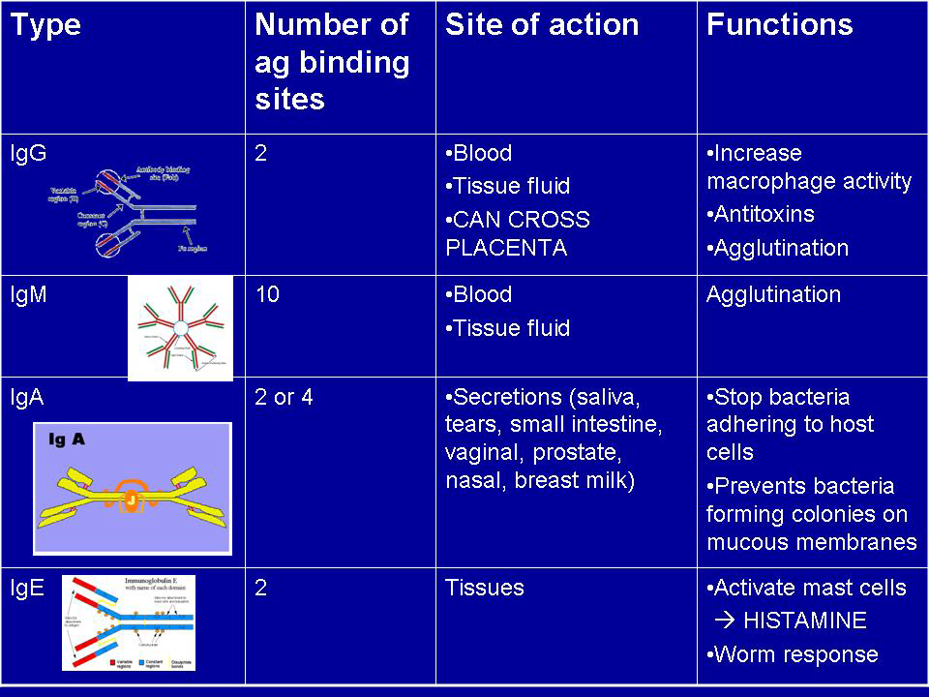
Immunoglobulins

Slide 39
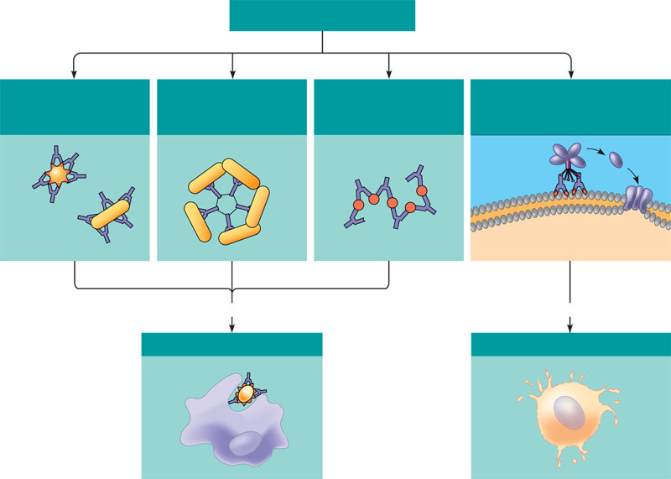
Antibody-mediated mechanisms of antigen disposal
Binding of antibodies to antigens
inactivates antigens by
Viral neutralization
(blocks binding to host)
and opsonization (increases
phagocytosis)
Agglutination of
antigen-bearing particles,
such as microbes
Precipitation of
soluble antigens
Activation of complement system
and pore formation
Virus
Bacteria
Complement
proteins
MAC
Pore
Bacterium
Soluble
antigens
Foreign cell
Enhances
Leads to
Phagocytosis
Cell lysis
Macrophage

Slide 40
