Slide 1
Chapter 3: STP
CCNA Routing and Switching
Scaling Networks v6.0
Notes:
Cisco Networking Academy Program
Scaling Networks v6.0
Chapter 3: STP

Slide 2
Chapter 3 - Sections & Objectives
3.1 Spanning Tree Concepts
Build a simple switched network with redundant links.
Explain common problems in a redundant, switched network.
Build a simple, switched network using STP.
3.2 Varieties of Spanning Tree Protocols
Explain how different varieties of spanning tree protocols operate.
Describe the different spanning tree varieties.
Explain how PVST+ operates.
Explain how Rapid PVST+ operates.
Notes:
2
Cisco Networking Academy Program
Scaling Networks v6.0
Chapter 3: STP

Slide 3
Chapter 3 - Sections & Objectives (Cont.)
3.3 Spanning Tree Configuration
Implement PVST+ and Rapid PVST+ in a switched LAN environment.
Configure PVST+ in a switched LAN environment.
Configure Rapid PVST+ in a switched LAN environment.
Analyze common STP configuration issues.
Notes:
3
Cisco Networking Academy Program
Scaling Networks v6.0
Chapter 3: STP

Slide 4
3.1 STP Operation
Notes:
3 – STP
3.1 – STP Operation

Slide 5
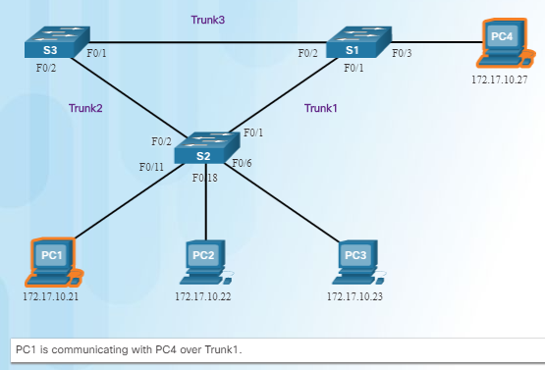
Spanning Tree Redundancy at OSI Layers 1 and 2
Switched networks commonly have redundant paths and even redundant links between the same two devices.
Redundant paths eliminate a single point of failure in order to improve reliability and availability.
Redundant paths can cause physical and logical Layer 2 loops.
Spanning Tree Protocol (STP) is a Layer 2 protocol that helps especially when there are redundant links.
Layer 2 loop issues
Mac database instability – copies of the same frame being received on different ports.
Broadcast storms – broadcasts are flooded endlessly causing network disruption.
Multiple frame transmission – multiple copies of unicast frames delivered to the same destination.
Notes:
3.1 – STP Operation
3.1.1 – Spanning Tree
3.1.1.1 – Redundancy at OSI Layers 1 and 2

Slide 6
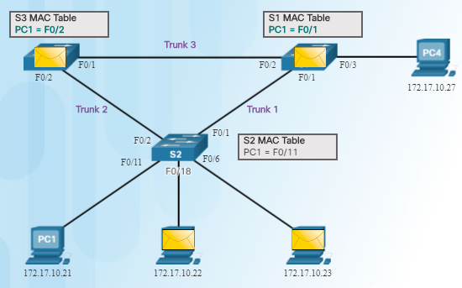
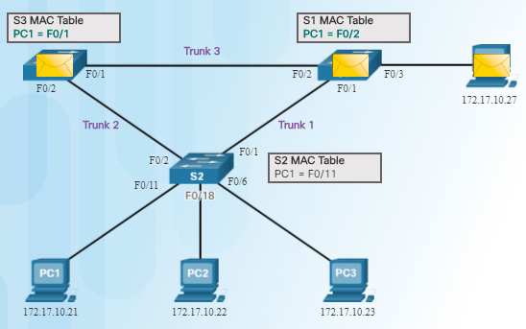
Spanning Tree Issues with Layer 1 Redundancy: MAC Database Instability
Ethernet frames do not have a time to live (TTL) field like the Layer 3 IP header has. This means that Ethernet has no mechanism to drop frames that propagate endlessly. This can
result in MAC database instability.
PC1 sends a broadcast frame to S2.
S2 updates the MAC address table for PC1’s MAC address on port 11.
S2 forwards the frame out all ports except the port the frame came in on. S1 and S3 receive the frame on a trunk and update their own MAC address tables that PC1 is reachable through the trunk port.
S1 and S3 send the frame out all ports except the port it came in on.
When S1 sends the frame out port 2 (Trunk 3), S3 updates the MAC address table to reflect that PC1 is now reachable through port 1.
A host caught in a network loop is not accessible to other hosts.
Due to constant changes in the MAC address table, Switches S3 and S1 do not know which port to forward frames.
Notes:
3.1 – STP Operation
3.1.1 – Spanning Tree
3.1.1.2 – Issues with Layer 1 Redundancy: MAC Database Instability

Slide 7
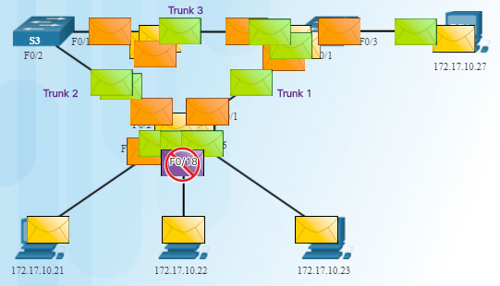
Spanning Tree Issues with Layer 1 Redundancy: Broadcast Storms
Broadcast storm – so many broadcast frames in a Layer 2 loop that use all available bandwidth and make the network unreachable for legitimate network traffic.
Causes a denial of service (DoS)
Can develop in seconds and bring the network down
Notes:
3.1 – STP Operation
3.1.1 – Spanning Tree
3.1.1.3 – Issues with Layer 1 Redundancy: Broadcast Storms

Slide 8
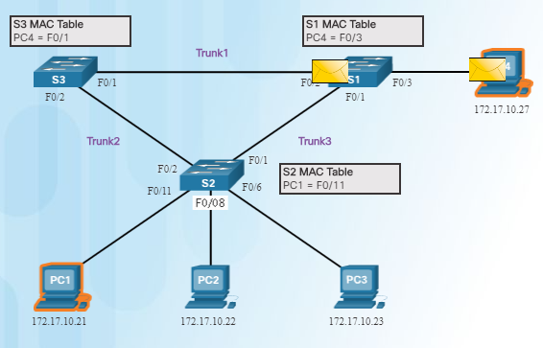
Spanning Tree Issues with Layer 1 Redundancy: Duplicate Unicast Frames
An unknown unicast frame is when the switch does not have the destination MAC address in its MAC address table and has to broadcast the frame out all ports except the port the frame was received on (the ingress port).
Unknown unicast frames sent onto a looped network can result in duplicate frames arriving at the destination device.
PC1 sends a frame destined for PC4.
S2 does not have PC4’s MAC address in the MAC address table so it forwards the frame out all ports including the trunks that lead to S1 and S3. S1 sends the frame to PC4. S3 also sends a copy of the frame over to S1 which delivers the same frame again to PC4.
Notes:
3.1 – STP Operation
3.1.1 – Spanning Tree
3.1.1.4 – Issues with Layer 1 Redundancy: Duplicate Unicast Frames

Slide 9
Types of NAT Packet Tracer – Examining a Redundant Design
Notes:
3.1 – STP Operation
3.1.1 – Spanning Tree
3.1.1.5 – Packet Tracer - Examining a Redundant Design

Slide 10
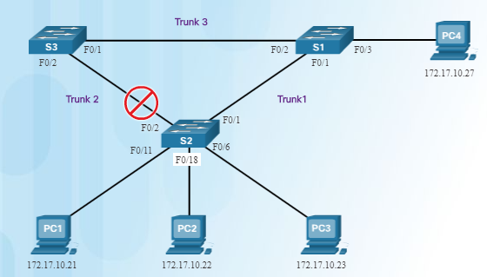
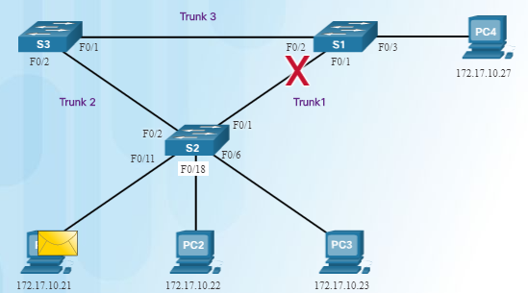
STP Operation Spanning Tree Algorithm: Introduction
The Spanning Tree Protocol (STP) creates one logical path through the switch network (all destinations on the network).
Blocks redundant paths that could cause a loop.
STP sends bridge protocol data units (BPDUs) between Layer 2 devices in order to create the one logical path.
A port on S2 is blocked so traffic can only flow one way between any two devices.
When Trunk1 fails, the blocked port on S2 is unblocked and traffic can flow between S2 and S3.
Notes:
3.1 – STP Operation
3.1.2 – STP Operation
3.1.2.1 – Spanning Tree Algorithm: Introduction

Slide 11
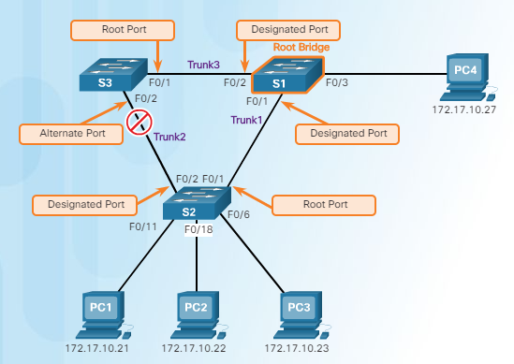
STP Operation Spanning Tree Algorithm: Port Roles
Root bridge – one Layer 2 device in a switched network.
Root port – one port on a switch that has the lowest cost to reach the root bridge.
Designated port – selected on a per-segment (each link) basis, based on the cost to get back to root bridge for either side of the link.
Alternate port – (RSTP only) backup port for the designated port when the other side is not a root port.
Backup port – (RSTP only) backup port for the root port.
Notes:
3.1 – STP Operation
3.1.2 – STP Operation
3.1.2.2 – Spanning Tree Algorithm: Port Roles

Slide 12
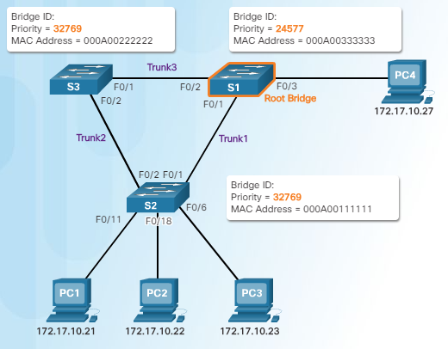
STP Operation Spanning Tree Algorithm: Root Bridge
Supports per-VLAN STP operations
Lowest bridge ID (BID) becomes root bridge
Originally BID had two fields: bridge priority and MAC address
Bridge priority default is 32,768 (can change)
Lowest MAC address (if bridge priority is not changed) becomes determinant for root bridge.
Notes:
3.1 – STP Operation
3.1.2 – STP Operation
3.1.2.3 – Spanning Tree Algorithm: Root Bridge

Slide 13
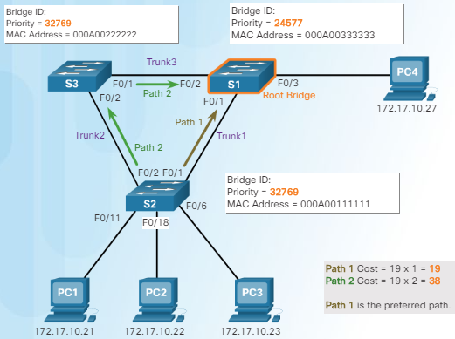
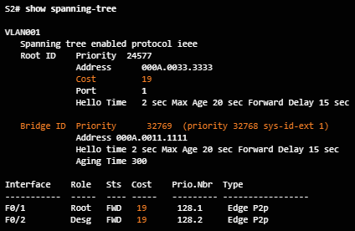
STP Operation Spanning Tree Algorithm: Root Path Cost
Root path cost is used to determine the role of the port and whether or not traffic is blocked.
Can be modified with the spanning-tree cost interface command.
Notes:
3.1 – STP Operation
3.1.2 – STP Operation
3.1.2.4 – Spanning Tree Algorithm: Root Path Cost

Slide 14
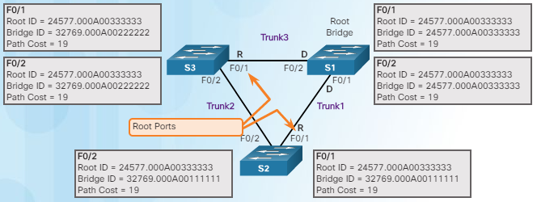
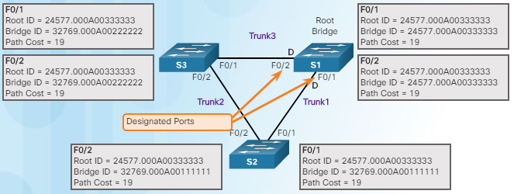
STP Operation Port Role Decisions for RSTP
S1 is root bridge
Notes:
3.1 – STP Operation
3.1.2 – STP Operation
3.1.2.5 – Port Role Decisions for RSTP

Slide 15
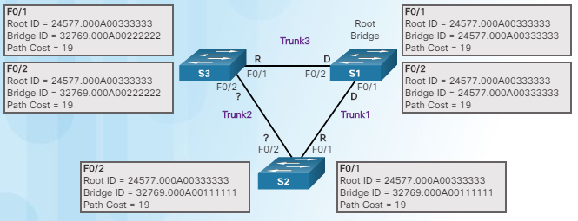
STP Operation Port Role Decisions for RSTP (Cont.)
Which port is the designated port?
Which switch (S3 or S2) has the lowest BID?
After S3 and S2 exchange BPDUs, STP determines that the F0/2 port on S2 becomes the designated port and the S3 F0/2 port becomes the alternate port, thus going into the blocking state so there is only one path through the switched network.
Notes:
3.1 – STP Operation
3.1.2 – STP Operation
3.1.2.5 – Port Role Decisions for RSTP (Cont.)

Slide 16
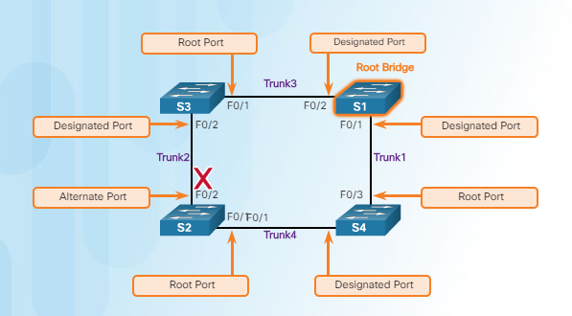
STP Operation Determine Designated and Alternate Ports
Remember port states are based on path cost back to root bridge.
Notes:
3.1 – STP Operation
3.1.2 – STP Operation
3.1.2.6 – Determine Designated and Alternate Ports

Slide 17
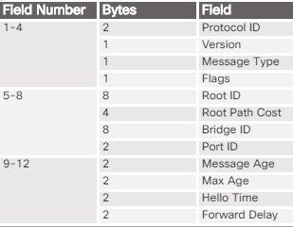
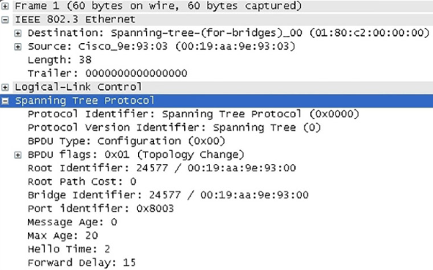
STP Operation 802.1D BPDU Frame Format
Field | Description
Protocol ID | Type of protocol being used; set to 0
Version | Protocol version; set to 0
Message type | Type of message; set to 0
Flags | Topology change (TC) bit signals a topology a change; topology change acknowldgment (TCA) bit used when a configuration message with the TC bit set has been received
Root ID | Root bridge information
Root path cost | Cost of the path from the switch sending the configuration message to the root bridge
Bridge ID | Includes priority, extended system ID, and MAC address ID of the bridge sending the message
Port ID | Port number from which the BPDU was sent
Message age | Amount of time since the root bridge sent the configuration message
Max age | When the current configuration message will be deleted
Hello time | Time between root bridge messages
Forward delay | Time the bridges should wait before going to a new state
Notes:
3.1 – STP Operation
3.1.2 – STP Operation
3.1.2.7 – 802.1D BPDU Frame Format

Slide 18
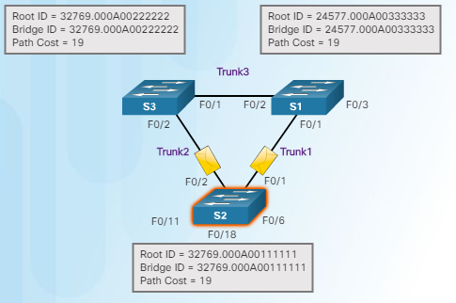
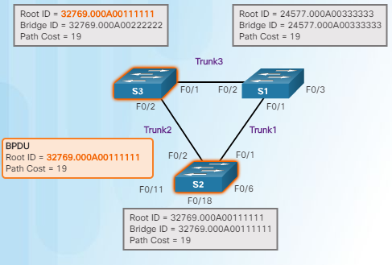
STP Operation 802.1D BPDU Propagation and Process
When a switch is powered on, it assumes it is the root bridge until BPDUs are sent and STP calculations are performed. S2 sends out BPDUs.
S3 compares its root ID with the BPDU from S2. S2 is lower so S3 updates its root ID.
Notes:
3.1 – STP Operation
3.1.2 – STP Operation
3.1.2.8 – 802.1D BPDU Propagation and Process

Slide 19
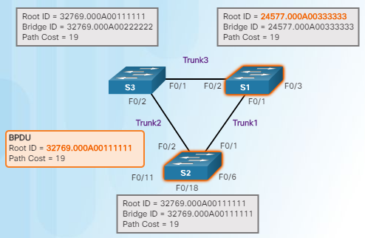
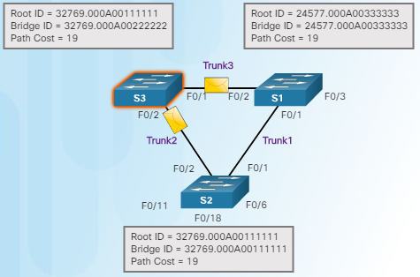
STP Operation 802.1D BPDU Propagation and Process (Cont.)
S1 receives the same information from S2 and because S1 has a lower BID, it ignores the information from S2.
S3 sends BPDUs out all ports indicating that S2 is root bridge.
Notes:
3.1 – STP Operation
3.1.2 – STP Operation
3.1.2.8 – 802.1D BPDU Propagation and Process (Cont.)

Slide 20
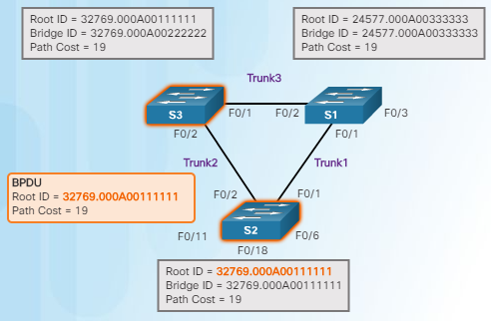
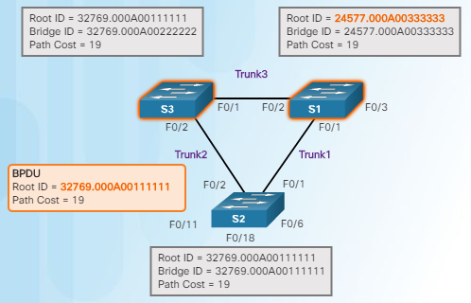
STP Operation 802.1D BPDU Propagation and Process (Cont.)
S2 compares the info from S3 so S2 still thinks it is root bridge.
S1 gets the same information from S3 (that S2 is root bridge), but because S1 has a lower BID, the switch ignores the information in the BPDU.
Notes:
3.1 – STP Operation
3.1.2 – STP Operation
3.1.2.8 – 802.1D BPDU Propagation and Process (Cont.)

Slide 21
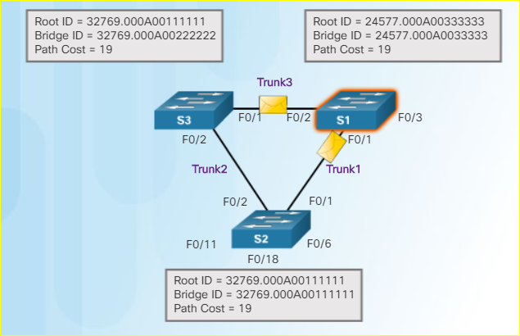
STP Operation 802.1D BPDU Propagation and Process (Cont.)
7. S1 now sends out BPDUs out all ports. The BPDU contains information designated S1 as root bridge.
Notes:
3.1 – STP Operation
3.1.2 – STP Operation
3.1.2.8 – 802.1D BPDU Propagation and Process (Cont.)

Slide 22
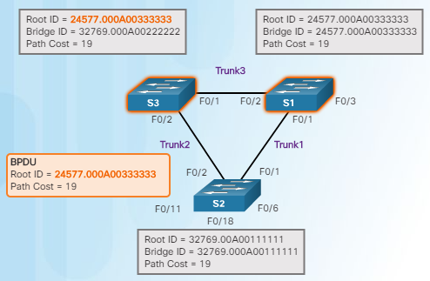
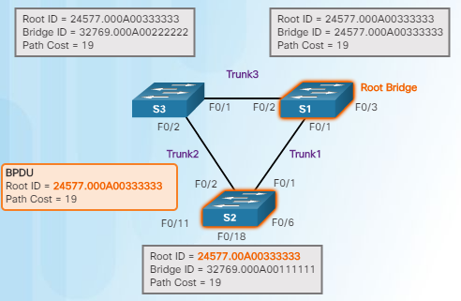
STP Operation 802.1D BPDU Propagation and Process (Cont.)
S3 compares the info from S1 so S3 now sees that the BID from S1 is lower than its stored root bridge information which is currently showing that S2 is root bridge. S3 changes the root ID to the information received from S1.
S2 compares the info from S1 so S2 now sees the BID from S1 is lower than its own BID. S2 now updates its own information showing S1 as root bridge.
Remember that after root bridge has been determined, the other port roles can be determined because those roles are determined by total path cost back to root bridge.
Notes:
3.1 – STP Operation
3.1.2 – STP Operation
3.1.2.8 – 802.1D BPDU Propagation and Process (Cont.)

Slide 23
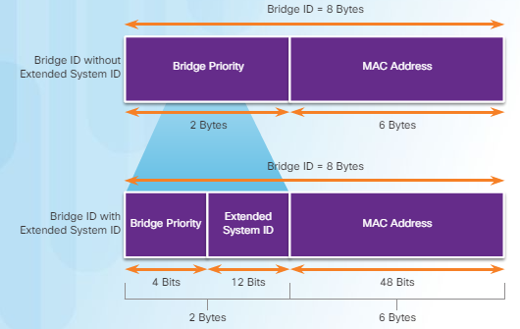
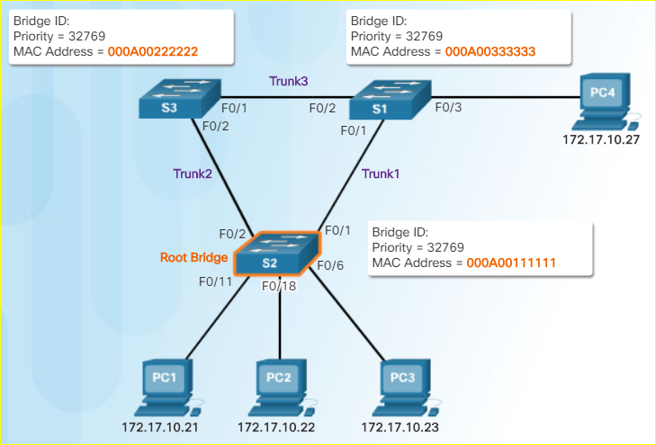
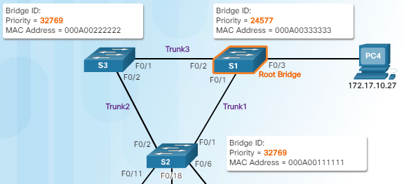
STP Operation Extended System ID
Remember - lowest BID becomes root
If priorities are all set to the default, lowest MAC address is the determining factor in lowest BID.
The priority value can be modified to influence root bridge elections.
Notes:
3.1 – STP Operation
3.1.2 – STP Operation
3.1.2.9 – Extended System ID

Slide 24
STP Operation Video Demonstration – Observing Spanning Tree Protocol Operation
Notes:
3.1 – STP Operation
3.1.2 – STP Operation
3.1.2.11 – Video Demonstration – Observing Spanning Tree Protocol Operation

Slide 25
STP Operation Building a Switched Network with Redundant Links
Notes:
3.1 – STP Operation
3.1.2 – STP Operation
3.1.2.12 – Lab – Building a Switched Network with Redundant Links

Slide 26
3.2 Types of Spanning Tree Protocols
Notes:
3 – STP
3.2 – Types of Spanning Tree Protocols

Slide 27
Varieties of Spanning Tree Protocols Types of Spanning Tree Protocols
STP Type | Description
802.1D | 1998 - Original STP standard
CST | One spanning-tree instance
PVST+ | Cisco update to 802.1D; each VLAN has its own spanning-tree instance
802.1D | 2004 – Updated bridging and STP standard
802.1w (RSTP) | Improves convergence by adding new roles to ports and enhancing BPDU exchange
Rapid PVST+ | Cisco enhancement of RSTP using PVST+
802.1s (MSTP) | Multiple VLANs can have the same spanning-tree instance
Notes:
3.2 – STP
3.2.1 – Varieties of Spanning Tree Protocols
3.2.1.1 – Types of Spanning Tree Protocols

Slide 28
Varieties of Spanning Tree Protocols Characteristics of Spanning Tree Protocols
STP Type | Standard | Resources Needed | Convergence | Tree Calculation
STP | 802.1D | Low | Slow | All VLANs
PVST+ | Cisco | High | Slow | Per VLAN
RSTP | 802.1w | Medium | Fast | All VLANs
Rapid PVST+ | Cisco | Very high | Fast | Per VLAN
MSTP | 802.1s | Medium or high | Fast | Per instance
Notes:
3.2 – STP
3.2.1 – Varieties of Spanning Tree Protocols
3.2.1.2 – Characteristics of Spanning Tree Protocols

Slide 29
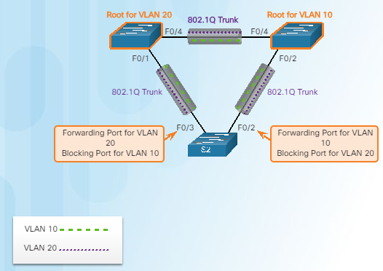
Varieties of Spanning Tree Protocols Overview of PVST+
Original 802.1D defines a common spanning tree
One spanning tree instance for the switched network (no matter how many VLANs)
No load sharing
One uplink must block for all VLANs
Low CPU utilization because only one instance of STP is used/calculated
Cisco PVST+ - each VLAN has its own spanning tree instance
One port can be blocking for one VLAN and forwarding for another VLAN
Can load balance
Can stress the CPU if a large number of VLANs are used
Notes:
3.2 – STP
3.2.1 – Varieties of Spanning Tree Protocols
3.2.2.1 – Overview of PVST+

Slide 30
Varieties of Spanning Tree Protocols Port States and PVST+ Operation
Port State
Operation allowed | Blocking | Listening | Learning | Forwarding | Disabled
Can receive/process BPDUs | Yes | Yes | Yes | Yes | No
Can forward data frames received on an interface | No | No | No | Yes | No
Can forward data frames switched from another interface | No | No | No | Yes | No
Can learn MAC addresses | No | No | Yes | Yes | No
Notes:
3.2 – STP
3.2.1 – Varieties of Spanning Tree Protocols
3.2.2.2 – Port States and PVST+ Operation

Slide 31
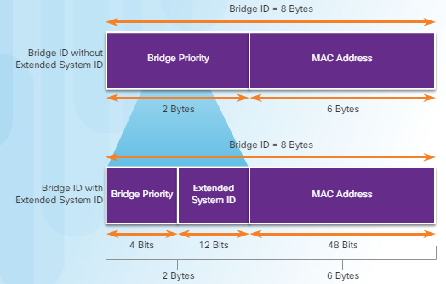
Varieties of Spanning Tree Protocols Extended System ID and PVST+ Operation
Remember that the BID is a unique ID
The extended system ID field ensures each switch has a unique BID for each VLAN.
The VLAN number is added to the priority value.
Example – VLAN 2 priority is 32770 (default value of 32768 plus the VLAN number of 2 equals 32770)
Can modify the priority number to influence the root bridge decision process
Reasons to select a particular switch as root bridge
Switch is positioned such that most traffic patterns flow toward this particular switch
Switch has more processing power (better CPU)
Switch is easier to access and manage remotely
Notes:
3.2 – STP
3.2.1 – Varieties of Spanning Tree Protocols
3.2.2.3 – Extended System ID and PVST+ Operation

Slide 32
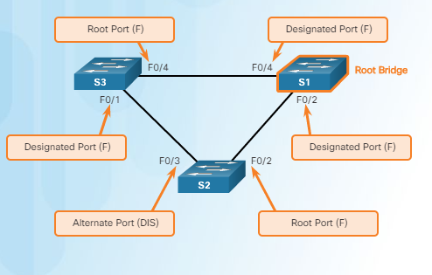
Varieties of Spanning Tree Protocols Overview of Rapid PVST+
Rapid PVST+ speeds up STP recalculations and converges quicker
Cisco version of RSTP
Two new port types
Alternate port (DIS)
Backup port
Independent instance of RSTP runs for each VLAN
Cisco features such as UplinkFast and BackboneFast are not compatible with switches that run RSTP
Notes:
3.2 – STP
3.2.1 – Varieties of Spanning Tree Protocols
3.2.3.1 – Overview of Rapid PVST+

Slide 33
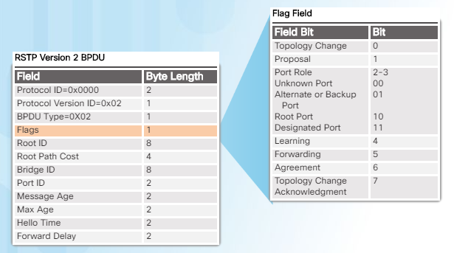
Varieties of Spanning Tree Protocols RSTP BPDUs
RSTP uses type 2, version 2 BPDUs
Original version was type 0, version 0
A switch using RSTP can work with and communicate with a switch running the original 802.1D version
BPDUs are used as a keepalive mechanism
3 missed BPDUs indicates lost connectivity
Notes:
3.2 – STP
3.2.1 – Varieties of Spanning Tree Protocols
3.2.3.2 – RSTP BPDUs

Slide 34
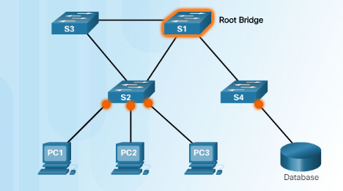
Varieties of Spanning Tree Protocols Edge Ports
Has an end device connected – NEVER another switch
Immediately goes to the forwarding state
Functions similar to a port configured with Cisco PortFast
Use the spanning-tree portfast command
Edge port
Edge port
Notes:
3.2 – STP
3.2.1 – Varieties of Spanning Tree Protocols
3.2.3.3 – Edge Ports

Slide 35
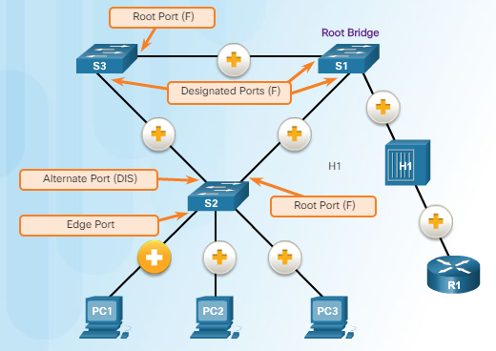
Varieties of Spanning Tree Protocols Link Types
Point-to-Point – a port in full-duplex mode connecting from one switch to another switch or from a device to a switch
Shared – a port in half-duplex mode connecting a hub to a switch
Point-to-Point
Shared
Notes:
3.2 – STP
3.2.1 – Varieties of Spanning Tree Protocols
3.2.3.4 – Link Types

Slide 36
3.3 Spanning Tree Configuration
Notes:
3 – STP
3.3 – Spanning Tree Configuration

Slide 37
PVST+ Configuration Catalyst 2960 Default Configuration
Feature | Default Setting
Enable state | Enabled on VLAN 1
Spanning-tree mode | PVST+ (Rapid PVST+ and MSTP are disabled)
Switch priority | 32768
Spanning-tree port priority (configurable on a per-interface basis) | 128
Spanning-tree port cost (configurable on a per-interface basis) | 1000 Mb/s: 4 100 Mb/s: 19 10 Mb/s: 100
Spanning-tree VLAN port priority (configurable on a per-VLAN basis) | 128
Spanning-tree VLAN port cost (configurable on a per-VLAN basis) | 1000 Mb/s: 4 100 Mb/s: 19 10 Mb/s: 100
Spanning-tree timers | Hello time: 2 seconds Forward-delay time: 15 seconds Maximum-aging time: 20 seconds Transmit hold count: 6 BPDUs
Notes:
3.3 – Spanning Tree Configuration
3.3.1 – PVST+ Configuration
3.3.1.1 – Catalyst 2960 Default Configuration

Slide 38
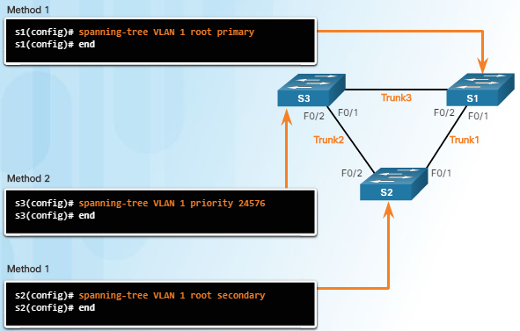
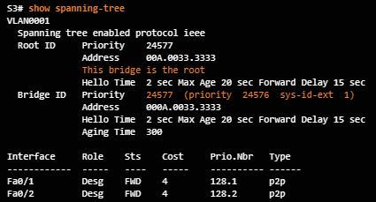
PVST+ Configuration Configuring and Verifying the Bridge ID
Two ways to influence the root bridge election process
Use the spanning-tree vlan x root primary or secondary command.
Change the priority value by using the spanning-tree vlan x priority x command.
Verify the bridge ID and root bridge election by using the show spanning-tree command.
Notes:
3.3 – Spanning Tree Configuration
3.3.1 – PVST+ Configuration
3.3.1.2 – Configuring and Verifying the Bridge ID

Slide 39
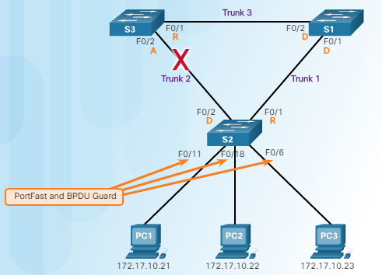
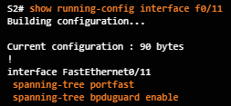
PVST+ Configuration PortFast and BPDU Guard
PortFast is used on ports that have end devices attached.
Puts a port in the forwarding state
Allows DHCP to work properly
BPDU Guard disables a port that has PortFast configured on it if a BPDU is received
Notes:
3.3 – Spanning Tree Configuration
3.3.1 – PVST+ Configuration
3.3.1.3 – PortFast and BPDU Guard

Slide 40
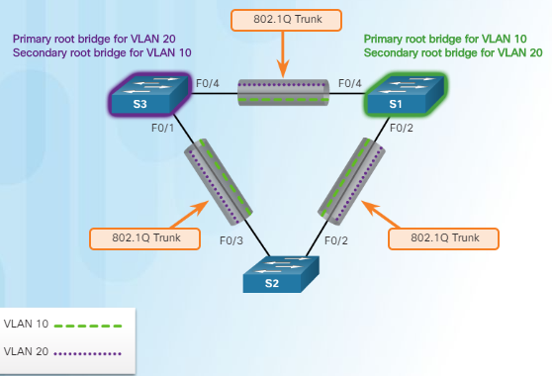
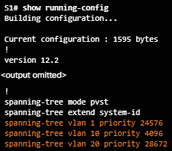
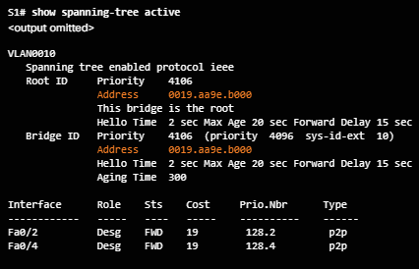
PVST+ Configuration PVST+ Load Balancing
or
or
Notes:
3.3 – Spanning Tree Configuration
3.3.1 – PVST+ Configuration
3.3.1.4 – PVST+ Load Balancing

Slide 41
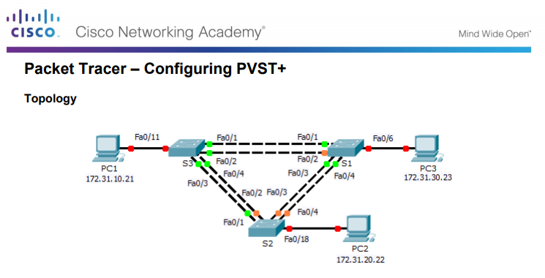
PVST+ Configuration Packet Tracer – Configuring PVST+
Notes:
3.3 – Spanning Tree Configuration
3.3.1 – PVST+ Configuration
3.3.1.5 – Packet Tracer – Configuring PVST+

Slide 42
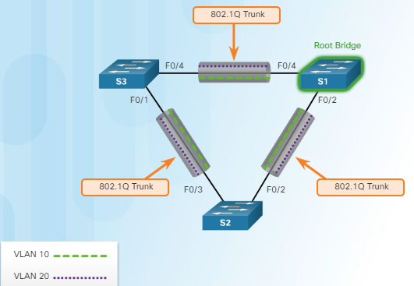
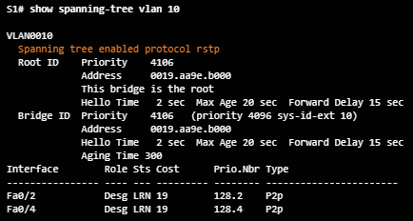
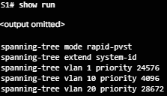
Rapid PVST+ Configuration Spanning Tree Mode
Rapid PVST+ supports RSTP on a per-VLAN basis.
Default on a 2960 is PVST+.
The spanning-tree mode rapid-pvst puts a switch into Rapid PVST+ mode.
The spanning-tree link-type point-to-point interface command designates a particular port as a point-to-point link (does not have a hub attached).
The clear spanning-tree detected-protocols privileged mode command is used to clear STP.
Notes:
3.3 – Spanning Tree Configuration
3.3.2 – Rapid PVST+ Configuration
3.3.2.1 – Spanning Tree Mode

Slide 43
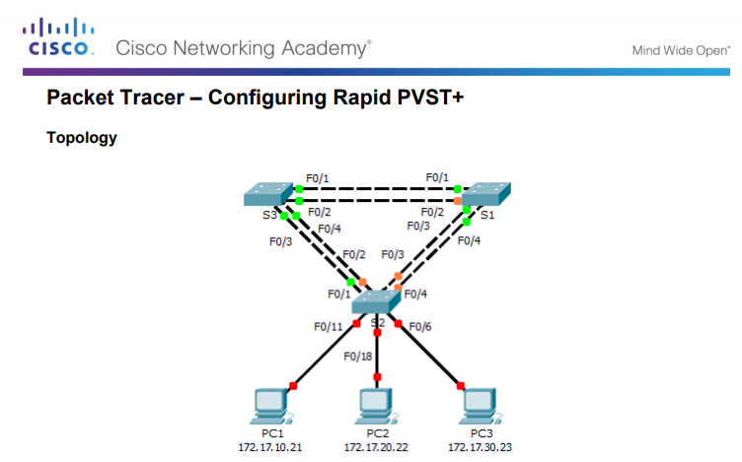
Rapid PVST+ Configuration Packet Tracer – Configuring Rapid PVST+
Notes:
3.3 – Spanning Tree Configuration
3.3.2 – Rapid PVST+ Configuration
3.3.2.2 – Packet Tracer – Configuring Rapid PVST+

Slide 44
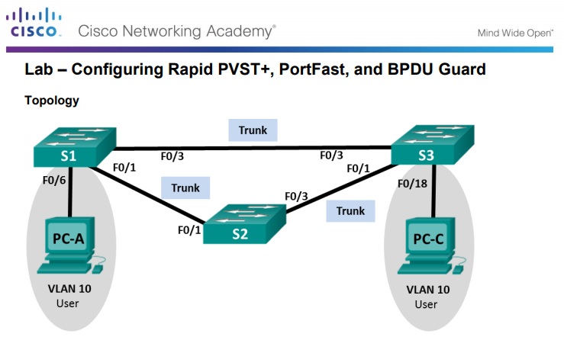
Rapid PVST+ Configuration Packet Tracer – Configuring Rapid PVST+, PortFast and BPDU Guard
Notes:
3.3 – Spanning Tree Configuration
3.3.2 – Rapid PVST+ Configuration
3.3.2.3 – Lab – Configuring Rapid PVST+, PortFast, and BPDU Guard

Slide 45
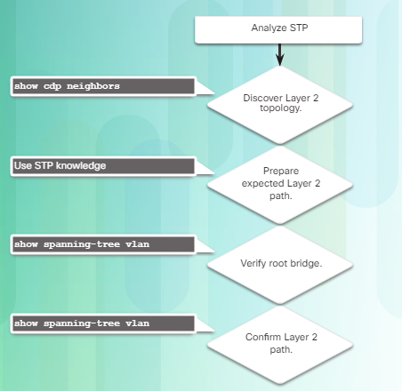
STP Configuration Issues Analyzing the STP Topology
Notes:
3.3 – Spanning Tree Configuration
3.3.3 – STP Configuration Issues
3.3.3.1 – Analyzing the STP Topology

Slide 46
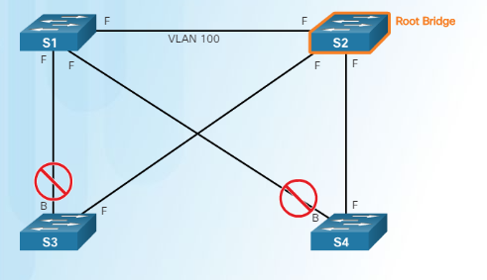
STP Configuration Issues Expected Topology Versus Actual Topology
Use show commands to verify STP. Do not forget to verify load balancing.
Ensure that the spanning-tree topology matches what is expected.
Notes:
3.3 – Spanning Tree Configuration
3.3.3 –STP Configuration Issues
3.3.3.2 – Expected Topology Versus Actual Topology

Slide 47
STP Configuration Issues Overview of STP Status
Use the show spanning-tree and show spanning-tree vlan x commands to verify the STP status.
Ten gigabit Ethernet interface
Notes:
3.3 – Spanning Tree Configuration
3.3.3 –STP Configuration Issues
3.3.3.3 – Overview of Spanning Tree Status

Slide 48
STP Configuration Issues Spanning Tree Failure Consequences
NEVER turn STP off; this can cause a switched network to be unusable – Remember that there is not a TTL mechanism at Layer 2.
Notes:
3.3 – Spanning Tree Configuration
3.3.3 –STP Configuration Issues
3.3.3.4 – Spanning Tree Failure Consequences

Slide 49
STP Configuration Issues Repairing a Spanning Tree Problem
Manually remove redundant links (physically remove the cable OR through configuration, if possible).
Determine and repair the cause of the spanning tree failure.
If unable to determine the problem, reinstall cables one at a time (or re-enable the ports) to locate the issue.
Notes:
3.3 – Spanning Tree Configuration
3.3.3 –STP Configuration Issues
3.3.3.5 – Repairing a Spanning Tree Problem

Slide 50
Switch Stacking and Chassis Aggregation Switch Stacking Concepts
Can connect up to nine 3750 switches
One switch (the stack master) controls the operation of the stack
If this switch goes down, a new stack master is elected
Appears as one entity to the network
Stack is assigned one IP address
Each switch has a unique stack member number
Can configure a priority value to determine which switch is stack master
Highest stack member priority value is stack master
The stack master has the saved and running configuration files for the entire stack.
Only one configuration file to manage and maintain
Notes:
3.3 – Spanning Tree Configuration
3.3.4 – Switch Stacking and Chassis Aggregation
3.3.4.1 – Switch Stacking Concepts

Slide 51
Switch Stacking and Chassis Aggregation Spanning Tree and Switch Stacks
Each stack appears as one spanning tree instance
Can add switches without affecting the STP diameter (the maximum number of switches data must cross to connect between any two switches)
IEEE recommends a maximum diameter of 7 switches for default STP timers
Default STP timers are hello – 2 seconds, max age – 20 seconds, forward delay timer – 15 seconds
Diameter of 9 from S1-4 to S3-4
With stacked switches, the diameter is now 3
Notes:
3.3 – Spanning Tree Configuration
3.3.4 – Switch Stacking and Chassis Aggregation
3.3.4.1 – Switch Stacking Concepts

Slide 52
9.4 Chapter Summary
Notes:
3 – STP
3.4 – Summary

Slide 53
Conclusion Chapter 3: STP
Build a simple switched network with redundant links.
Explain how different varieties of spanning tree protocols operate
Implement PVST+ and Rapid PVST+ in a switched LAN environment.
Notes:
3.4 – Summary
3.4.1 – Conclusion

Slide 54
Module 3 New Terms and Commands
Broadcast storm MAC database instability Spanning tree algorithm Spanning Tree Protocol BPDU Loop-free path RSTP MSTP IEEE 802.1D Root port Designated port Alternate port Backup port Spanning Tree instance BID Root ID | Bridge priority value Root path cost show spanning-tree spanning-tree cost Extended system ID CST PVST+ 802.1w Rapid PVST+ 802.1s Edge port Point-to-point link Shared link spanning-tree portfast spanning-tree VLAN root primary | spanning-tree VLAN root secondary spanning-tree VLAN priority spanning-tree bpduguard enable show spanning-tree active spanning-tree mode rapid-pvst show spanning-tree vlan spanning-tree link-type point-to-point clear spanning-tree detected-protocols show cdp neighbors Switch stack Stack master
Notes:
Module 3 - New Terms and Commands

