Slide 1
Is St.Valentine’s Day an old holiday? Is it still popular today?
How long have people been celebrating this holiday?
Notes:
Warm-up: you can ask your students share their ideas with their peers.

Slide 2
Read the following sentences and classifiy them into finished and unfinished.
They’ve bought a new car.
I’ve been thinking about you.
She’s been living in NY since 2016.
We’ve found a wallet whose owner is 65 years old.
It might seem crazy what she’s been doing.
Notes:
Ask questions such as “Are they still buying the car?” To help you sts understand the conception, if necessary.

Slide 3
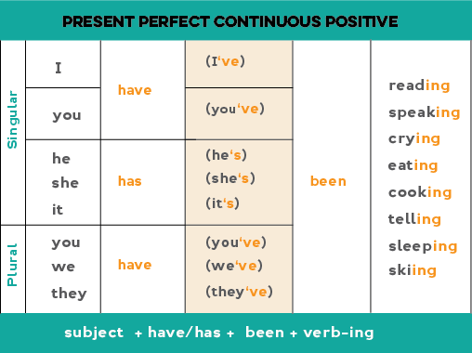
Present Perfect Continuous
Notes:
Explain to your students the structures (positive and interggoative). Elict examples.

Slide 4
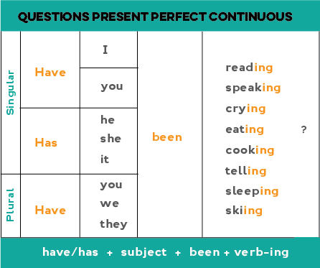
Present Perfect Continuous
Notes:
Explain to your students the structures (positive and interggoative). Elict examples.

Slide 5
We use the Present Perfect Continuous to show that something started in the past and has continued up until now.
"For five minutes," "for two weeks," and "since Tuesday" are all durations which can be used with the Present Perfect Continuous.
She has been working at that company for three years
“For three years”, gives us the notion of her work length.
Present Perfect Continuous focus on the duration of the action.
Notes:
http://www.englishpage.com/verbpage/presentperfectcontinuous.html

Slide 6
FOR and SINCE
We often use for and since with perfect tenses:
We use for to talk about a period of time: three hours, two months, one decade.
We use since to talk about a starting point in past time: 9 o'clock, 1st January, Monday.
Any questions?

Slide 7
Time to practice!
Have been waiting
Has been living
Has been playing
Have you been learning
Have been looking for
Have been living
Hasn’t been running
Has she been working
Hasn’t been
Notes:
Ask your sts to complete the sentences orally and click to reveal the answers.

Slide 8
Conversation moment
Answer these questions
How long have you been studying English?
What TV shows or sitcoms have you been watching? How do you like them?
What kinds movies have you been watching recently? Would you recommend any?
Who haven’t you been meeting latelty?
Which skills have you been practicing more: writing your listening?
In which restaurtant have you been eating recently?
Are there any blogs that you’ve been following? Which ones?
Notes:
Pair up the students and have them practice orally. Check for pronunciation and correct use of the tense. Click to show the suggested topics.

