Slide 1
ACADEMIC WRITING
Сritical thinking.
Evaluating the sources.

Slide 2
Module 2 Classes (3-4) Academic reading and critical thinking
Students are expected to adopt a critical approach to sources.
This unit:
focuses on evaluating different types of sources;
explores levels of formality and marked language;
explores and practises critical analysis of texts;
develops note-taking and paraphrasing methods;
introduces writing critical response to a text.

Slide 3
The Nature of Writing
Writing is a complex process that requires a number of various skills.
Approaches to writing: writing as a process vs. writing as a product
Questions: Yakhontova. Academic Writing Task 4 pages 18-20

Slide 4
Writing: key advice
Discuss your writing advice preferences with a partner/a small group and support them with appropriate arguments.
Yakhontova. Academic Writing Task 5 page 20

Slide 5
Cultural Differences in Writing
Yakhontova. Academic Writing Task 6-7 pages 21-22

Slide 6
Answer key
Task 6 Features 2 , 4 , 5 , 6 , and 10 are generally considered to be rather typical of Anglo-
American research texts (although this does not mean that features 1 , 3 , 7 , 8,and 9 never occur in them).
Task 7 According to statistical data obtained in one research, the types of the titles in 2 , 3 , and 6 are frequently used by English authors, while the title structures listed under 1, 4, and 5 are much more favoured by Ukrainian writers.

Slide 7
Evaluating the sources
Different types of sources and how reliable they are:
academic textbooks=reliable (have been carefully checked);
journal articles=reliable (peer-reviewed);
popular academic texts for a non-expert audience =may provide background reading, but may not be appropriate to cite as evidence;
non-academic sources (e.g. journalistic texts) =relevant to cite a recent example;
academic blogs/online forums=useful for keeping up-to date, links to journal articles

Slide 8
Evaluating your sources
1) В мережі Інтернет та на сайтах міжнародних наукових журналів або наукометричних баз SCOPUS чи Web of Science знайдіть 3 статті за тематикою свого магістерського дослідження.
Use the table (next slide) to comment on the suitability and relevance of the selected source

Slide 9
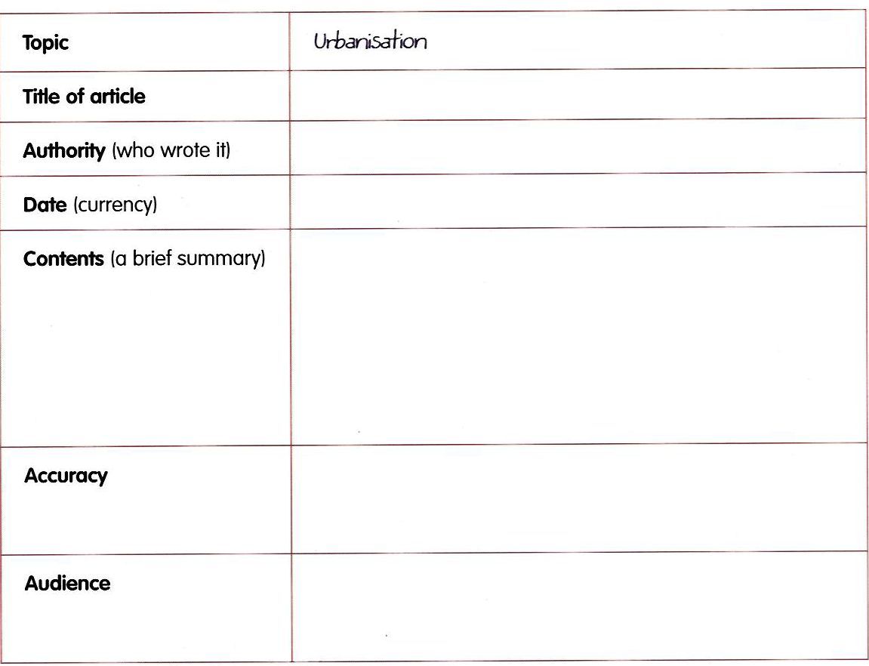

Slide 10
Practice. Evaluating the sources
Class handout 3 (.pdf file) –task 1 exercises 1-3.

Slide 11
Answer key
1 B academic
2 A academic
3 C popular academic
4 F popular academic
5 D non-academic*
6 E academic (but informal)

Slide 12
Practice. Summarising the sources
Handout class 2 task VIII, IX +Home task section (tasks 1-10)

Slide 13
Answers. Tasks 7-10
7)1 attribute 2 better 3 information
8) 1 documented, attributed, unsupported, unfounded 2 reality, interpretation, speculation, guesswork 3 transcribe, report, interpret, comment
9) 1 Words related to facts: facts, information, sources, records, interview 2 Words related to activities around facts: corroboration, attribution / attributed, report, double-checked, transcribed, confirmation, investigate
10) These words are essentially evaluative words related to facts and doing things with facts. Further examples from the texts could include: documented proof, better, trustworthy, needed, of course, credibility.

Slide 14
Practice. Recognizing narrative in source texts
Class handout 3 (.pdf file) –task 2 exercises 1-5.

Slide 15
Practice. Identifying writing styles
Class handout 3 (.pdf file) –task 3 exercise 1.
task 4 exercise 1-2

Slide 16
Home Assignment
Class handout 3 (.pdf file) task 5 exercises 1-3;
Class handout 4 (.pdf file) tasks 1-5 (all exercises in tasks)
Test 2 (Moodle)

